Slide 1
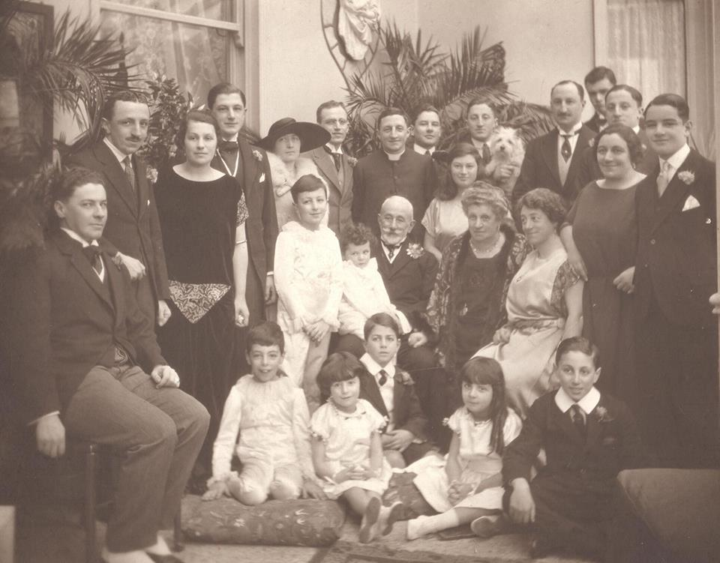
Friends of Valletta
A Malta Family History
by
Peter Agius

Slide 3
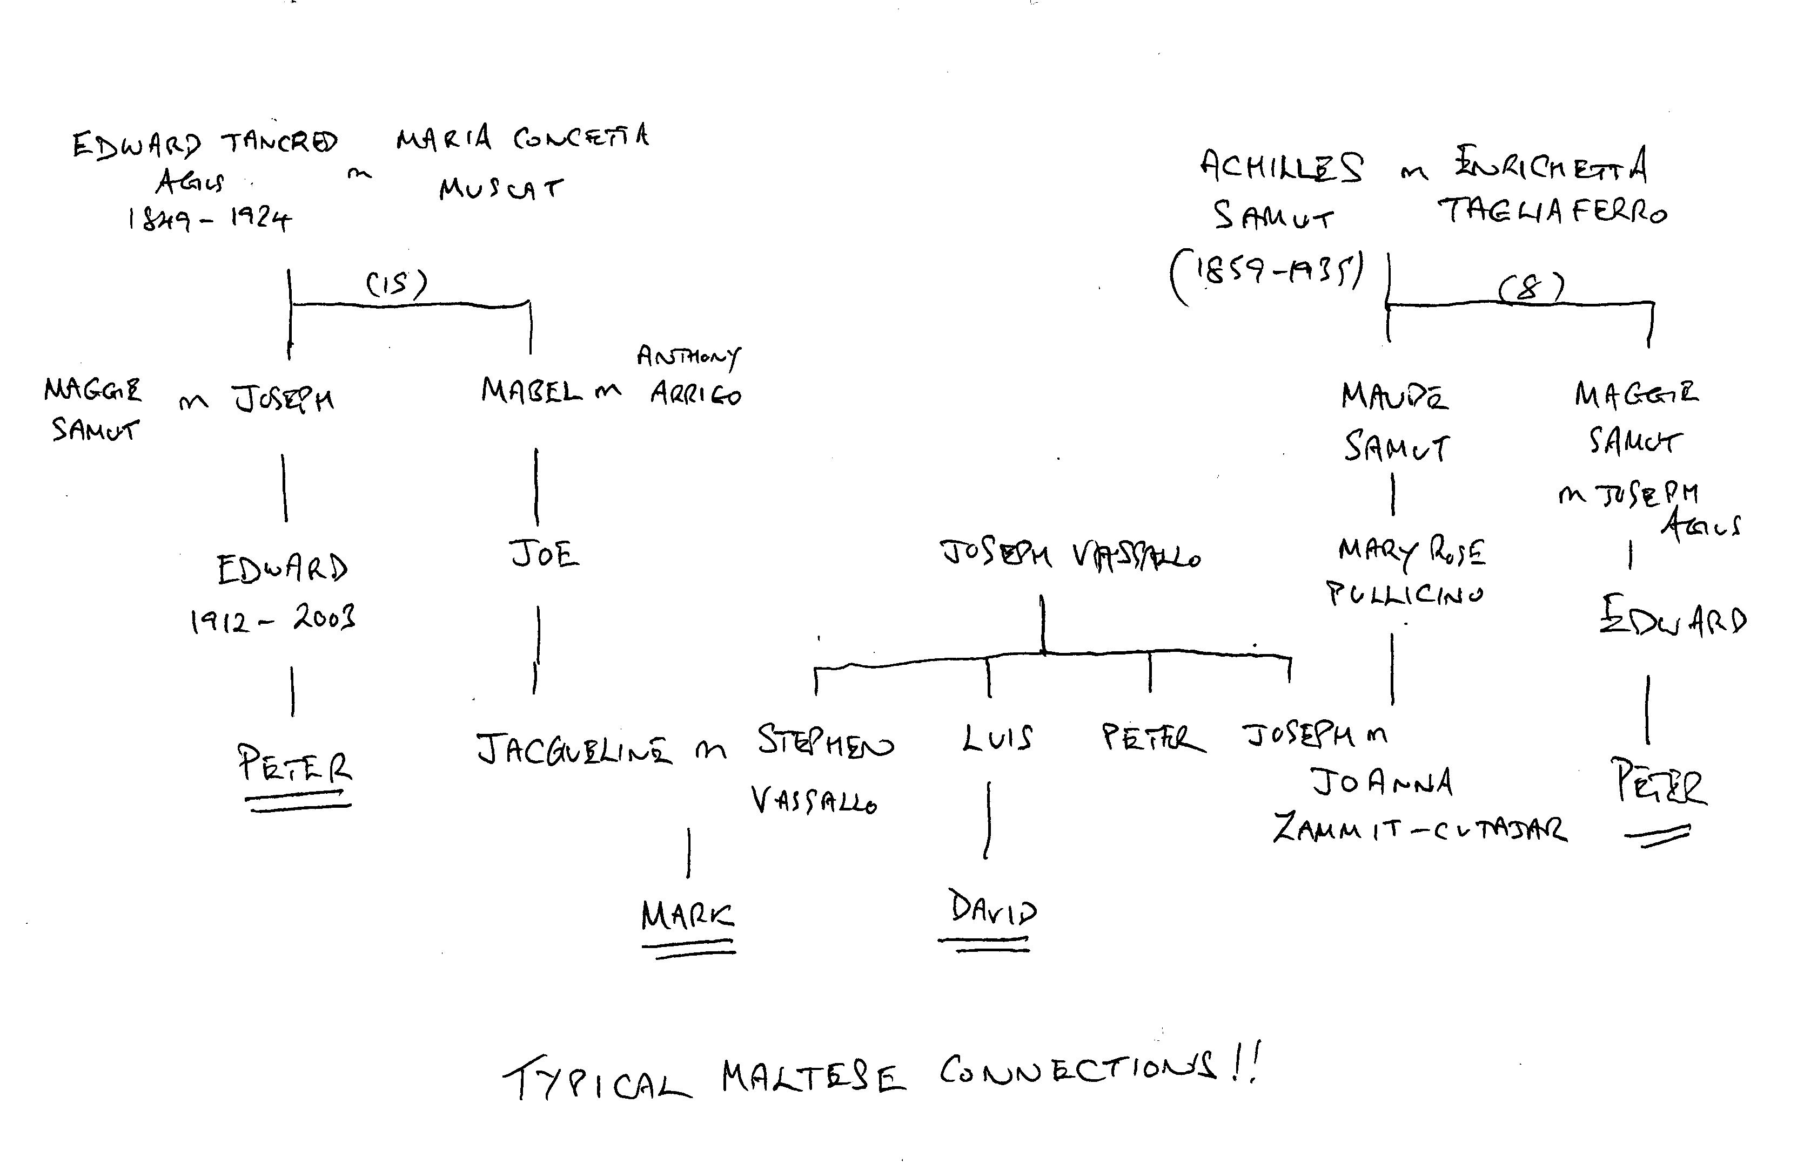

Slide 4
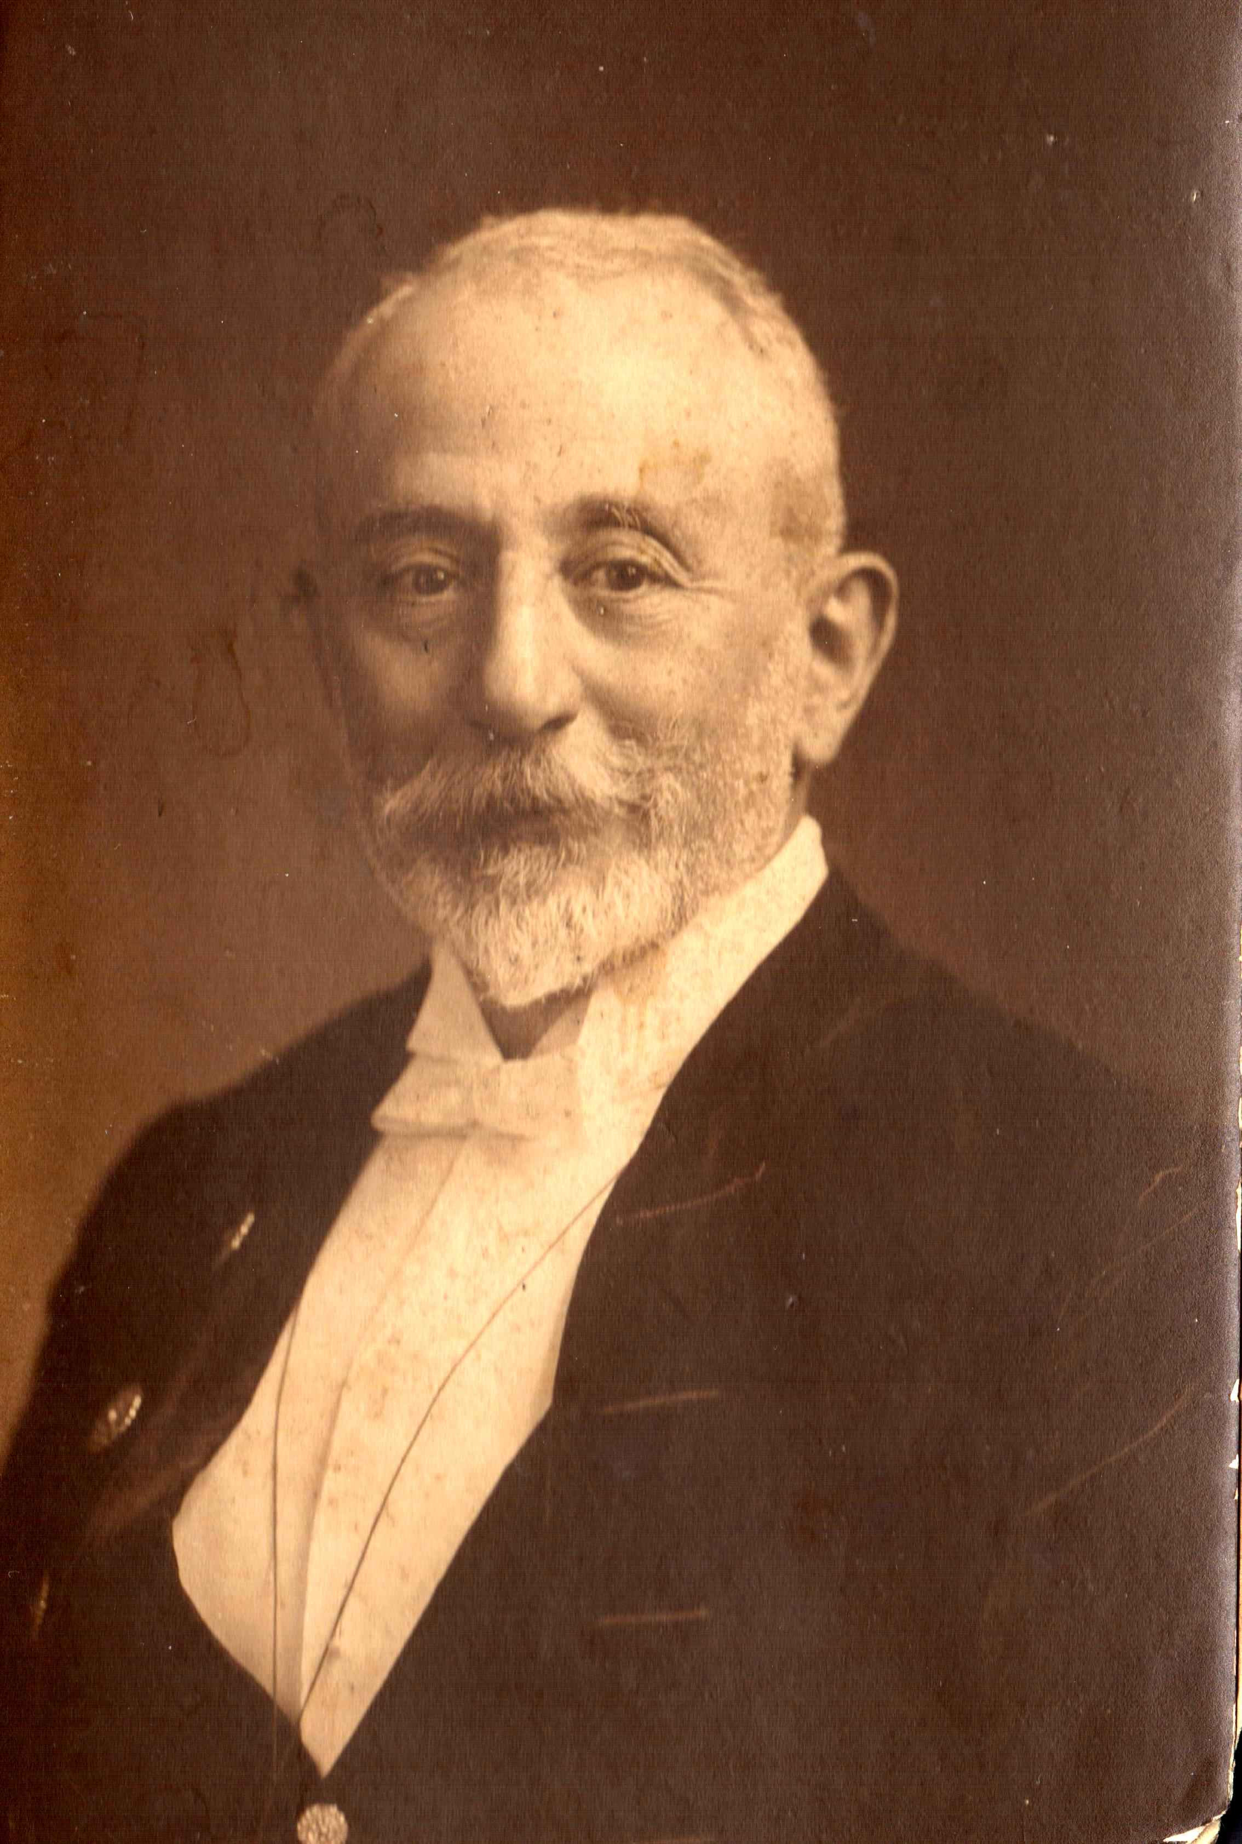
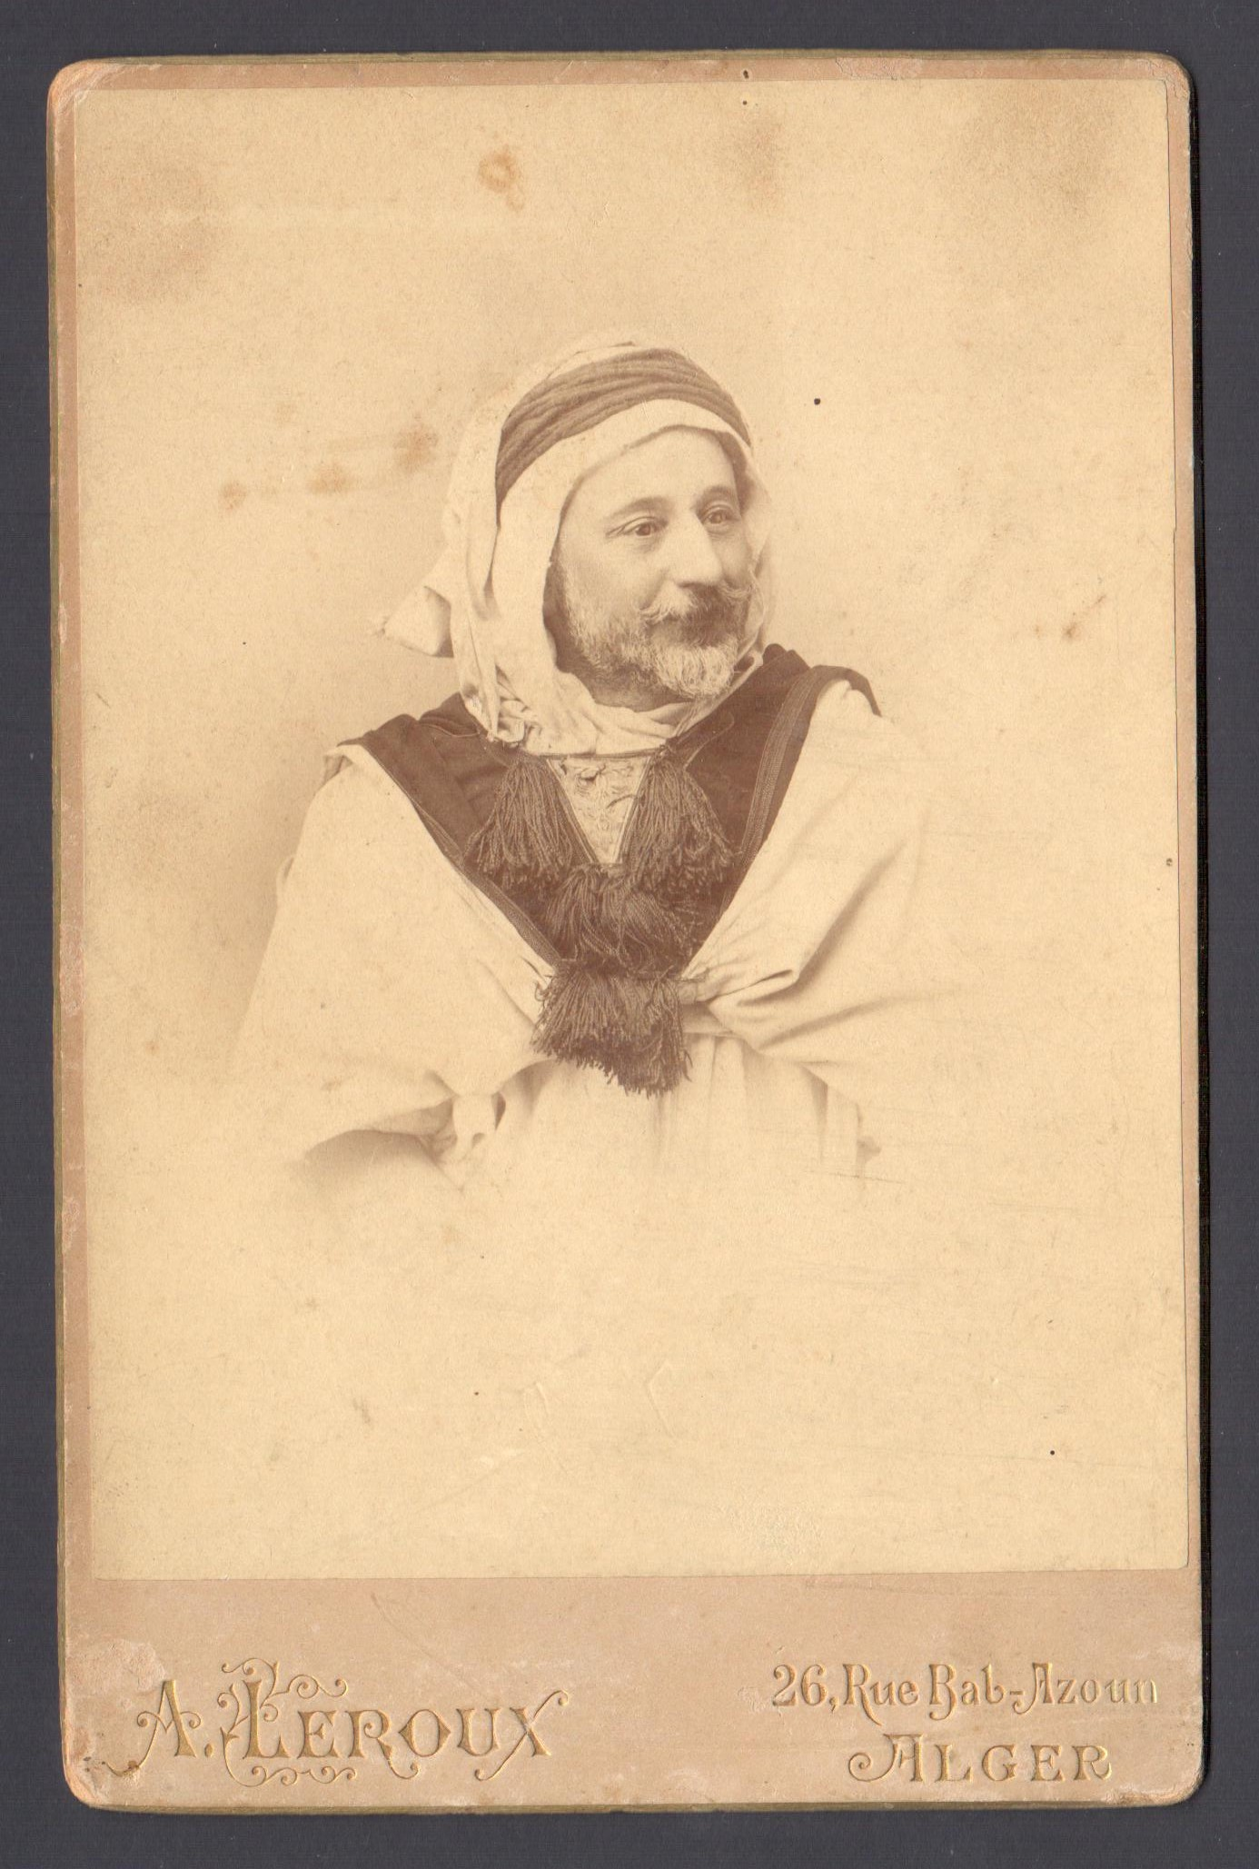
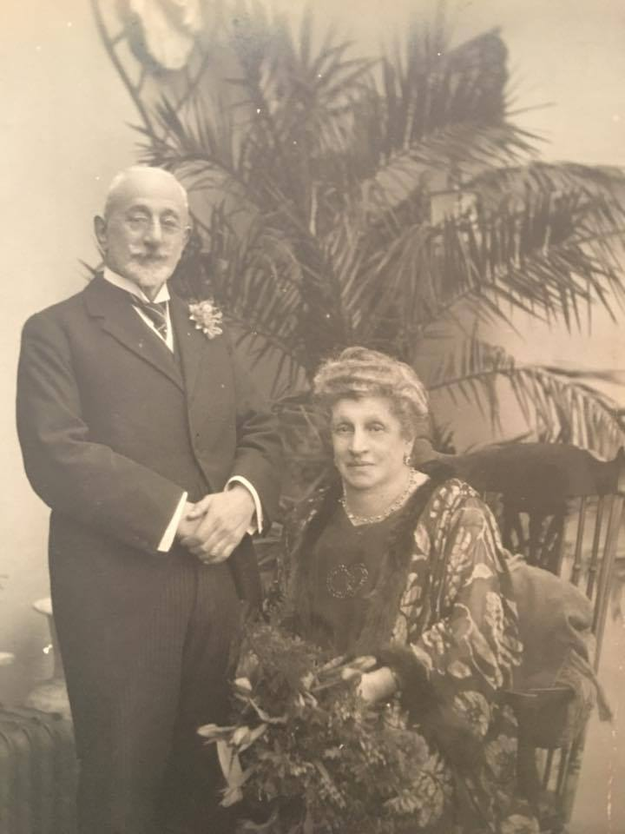
Edward Tancred Agius 1849 - 1924

Slide 5
The Golden Wedding
of
Edward Tancred Agius
&
Maria Concetta Muscat
January 1923

Slide 6
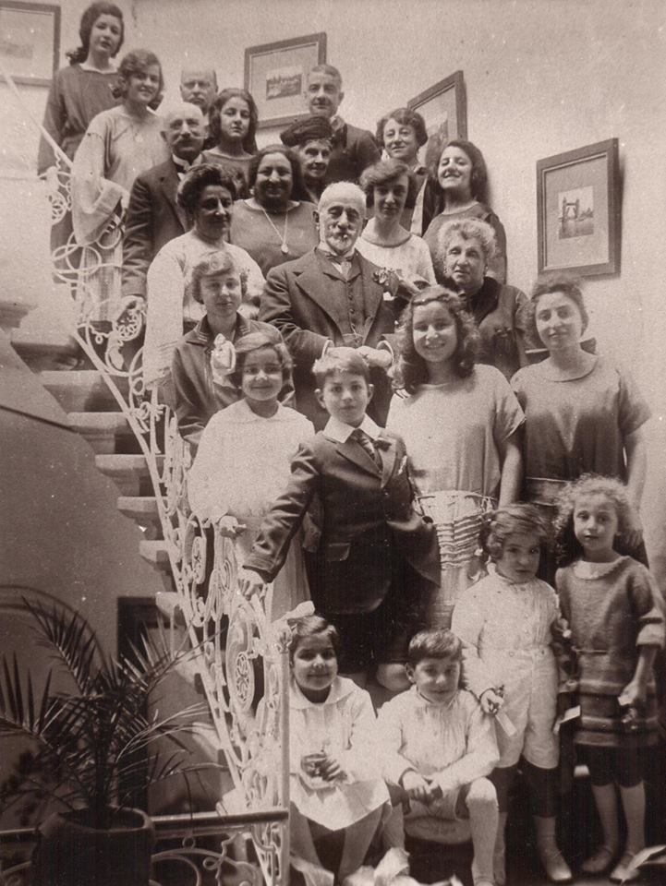
Golden Wedding Part 2
at
the Osborne Hotel in Valletta
July 1923

Slide 7
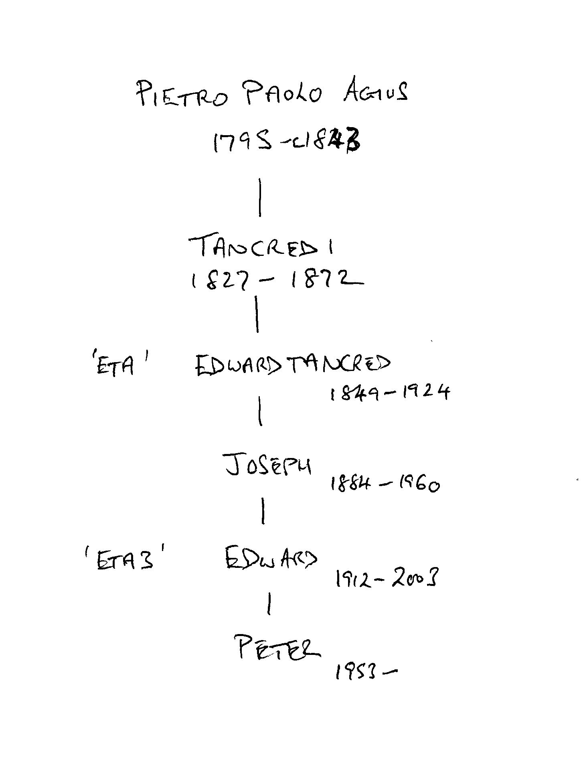
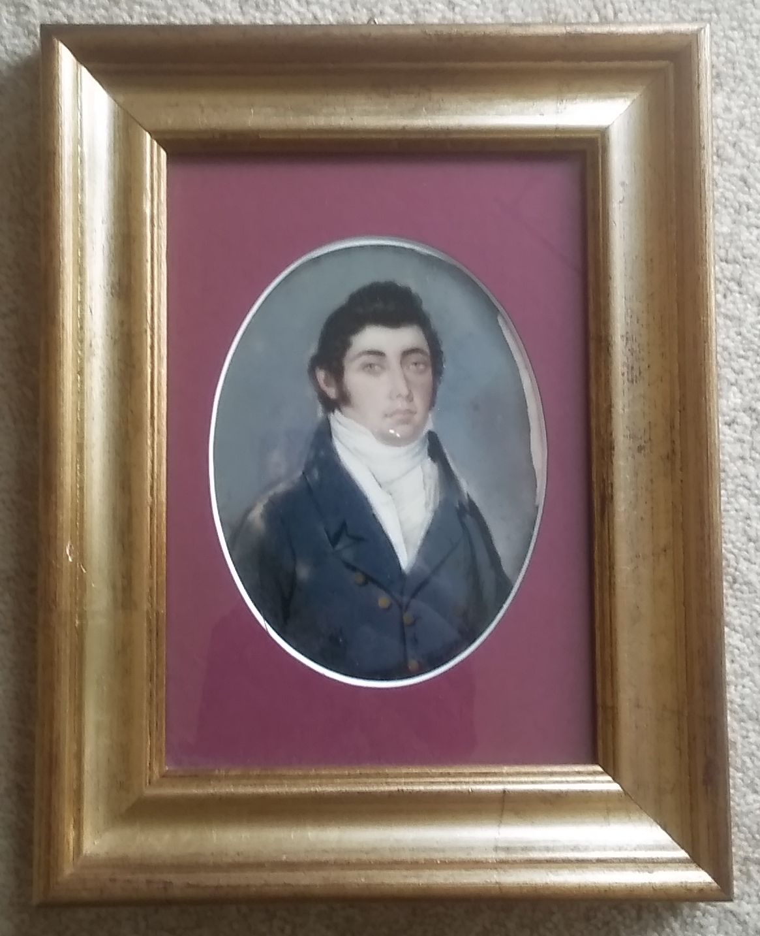

Slide 8
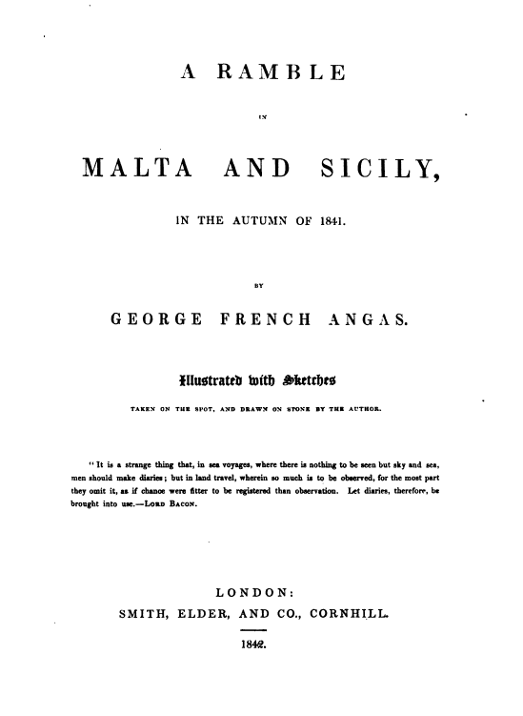

Slide 9
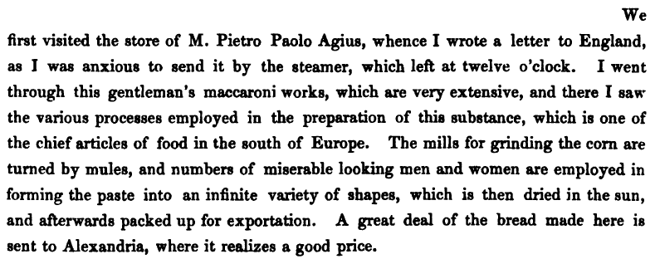

Slide 10
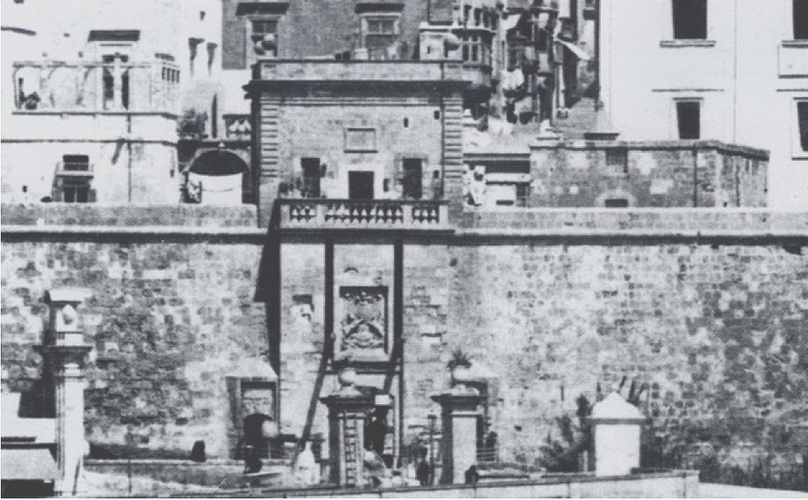
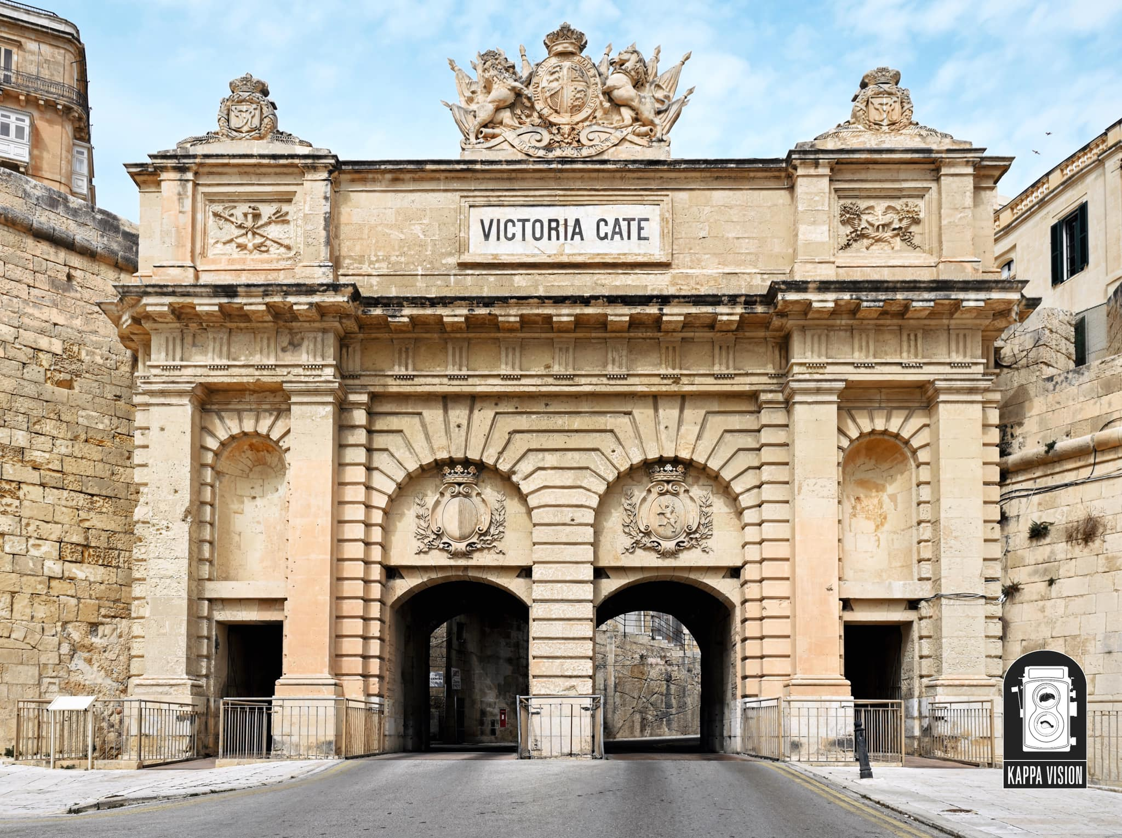
Marina Gate …replaced by the Victoria Gate

Slide 11
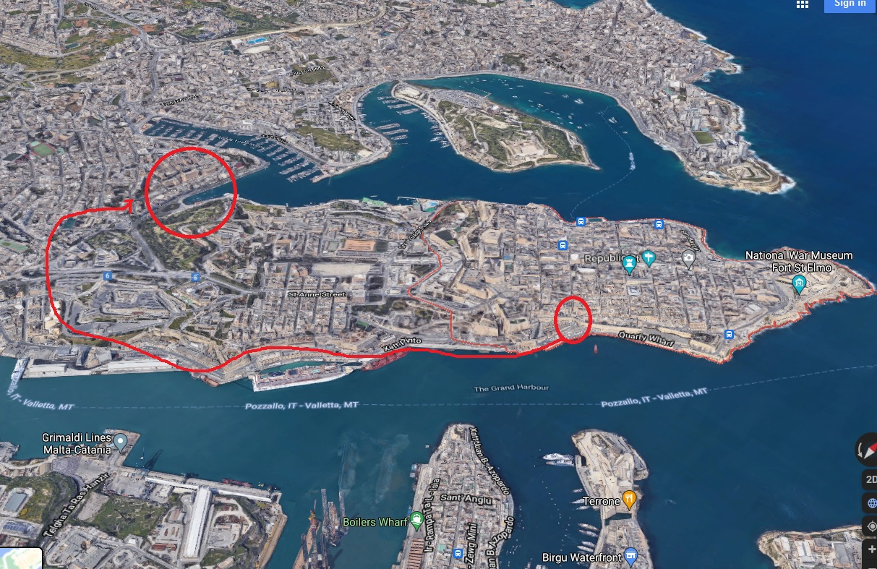

Slide 12
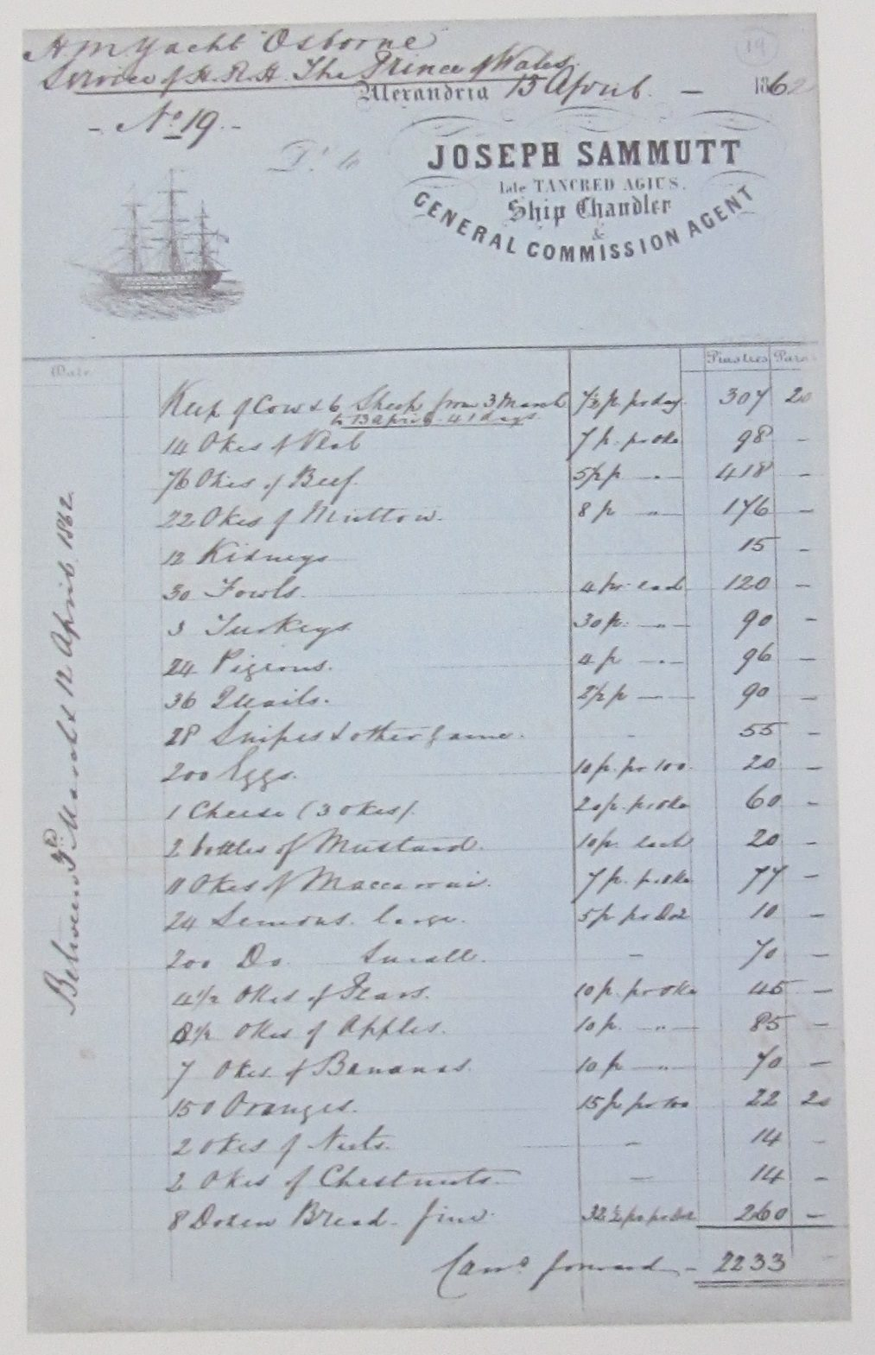
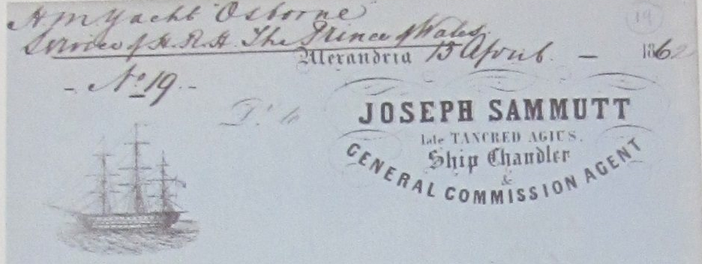
Invoice for supplies to the Royal Yacht on the Prince of Wales tour of the empire 1862, which tells of the business of Joseph Sammutt late Tancred Agius , Ship Chandler and General Commission Agent.

Slide 13
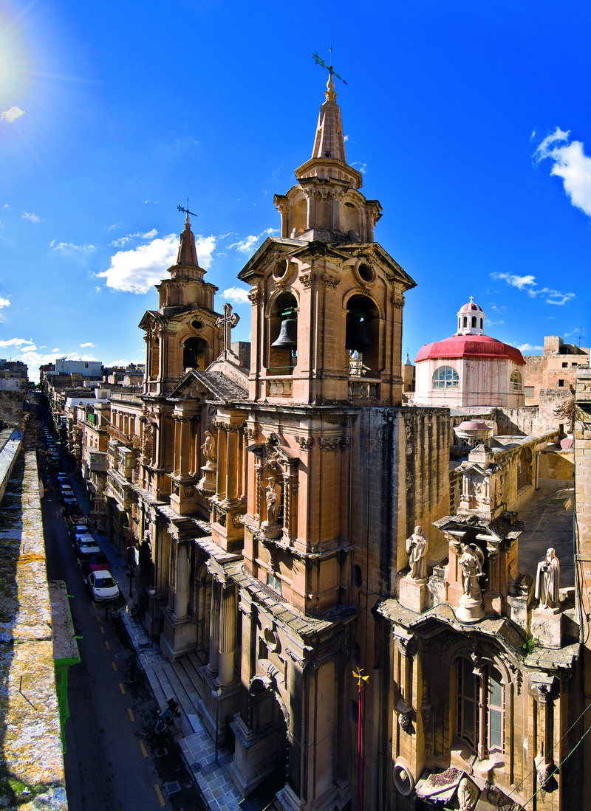
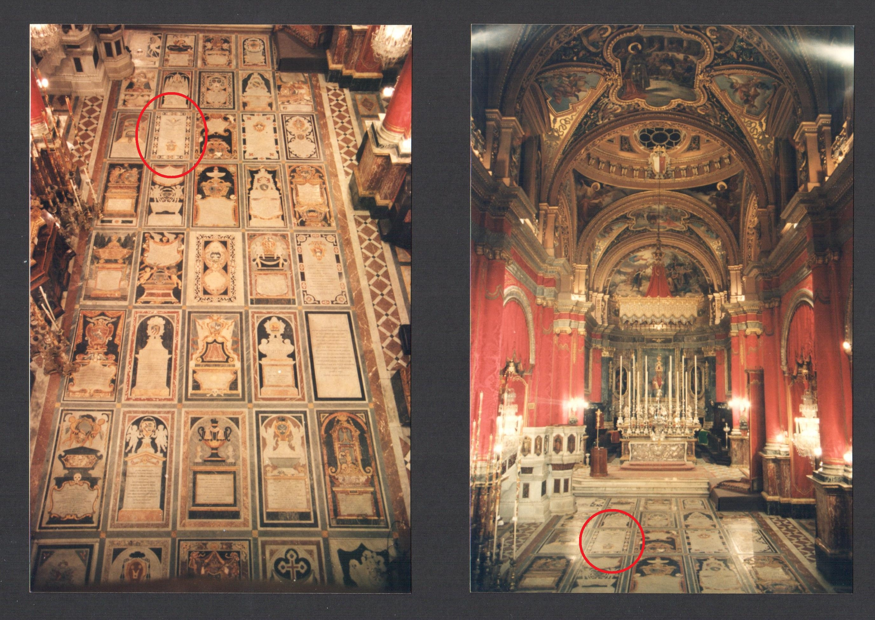

Slide 14
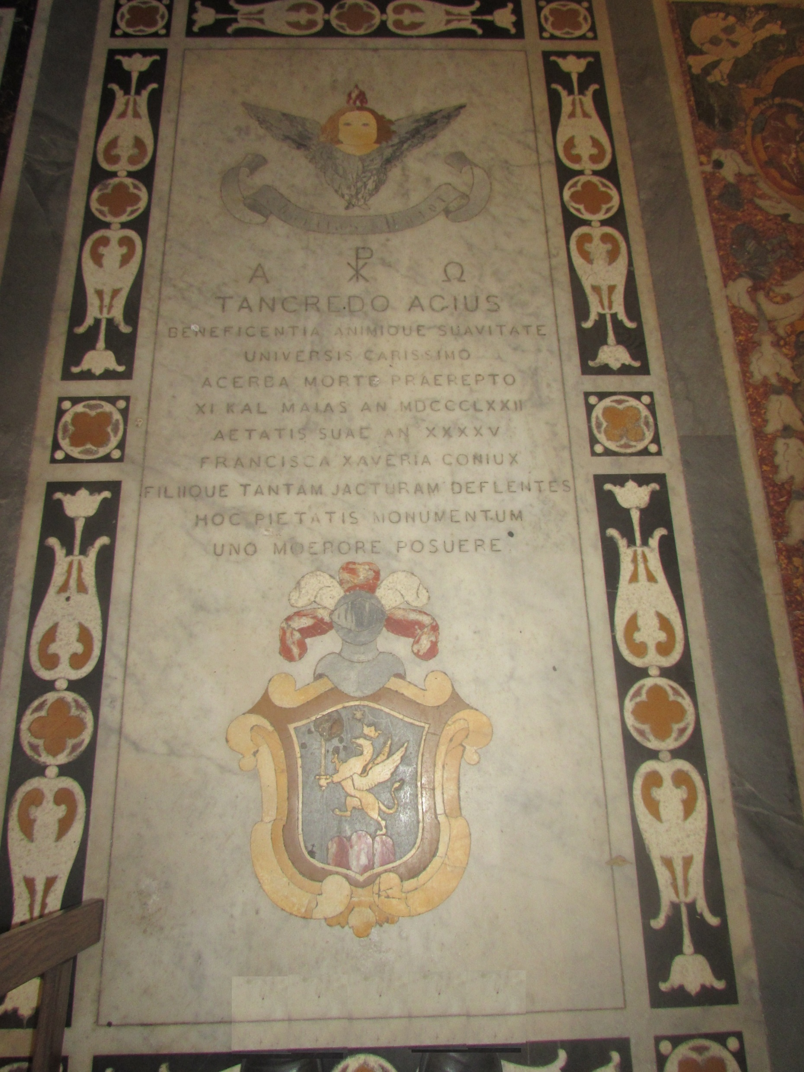
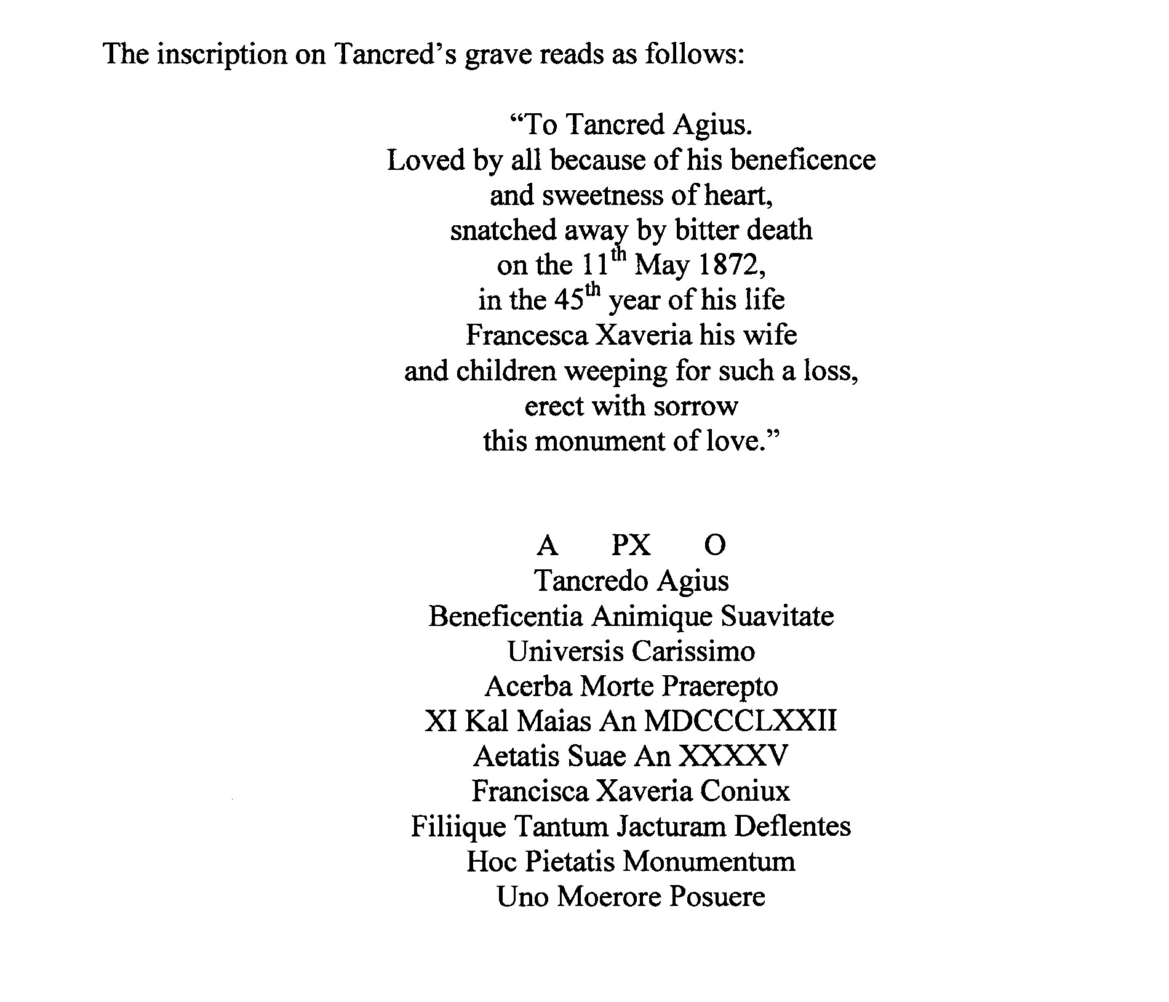

Slide 15
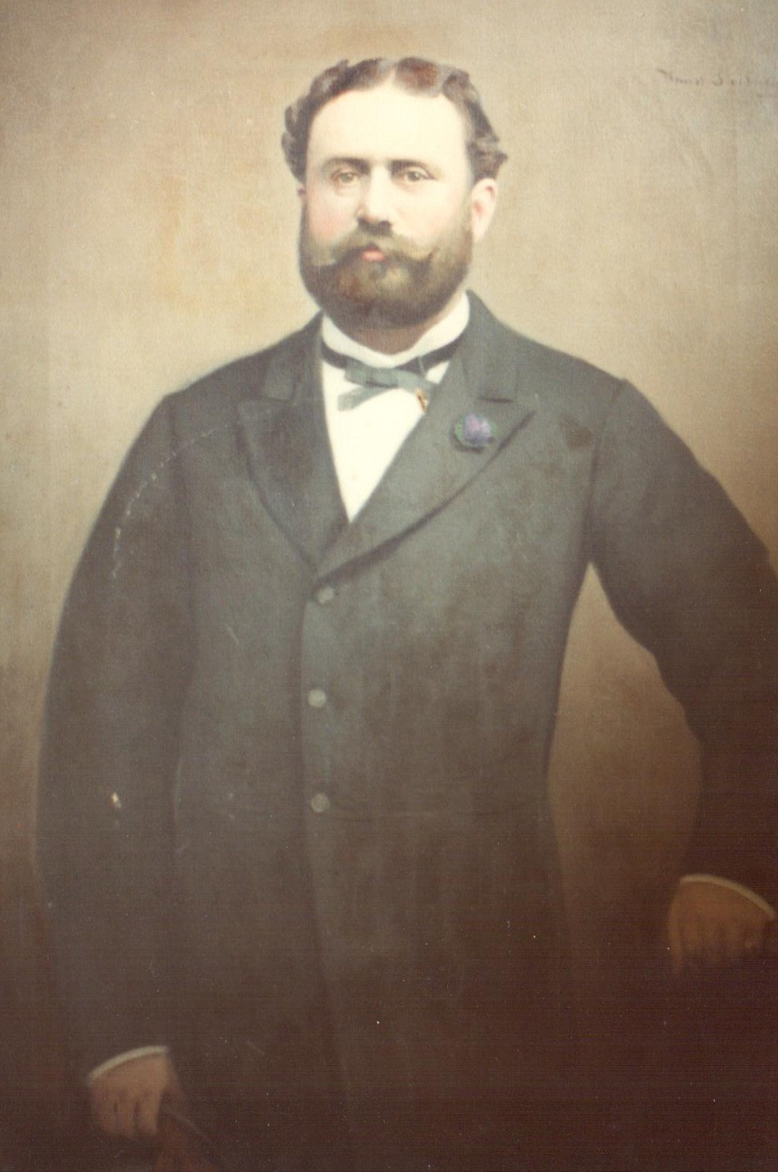
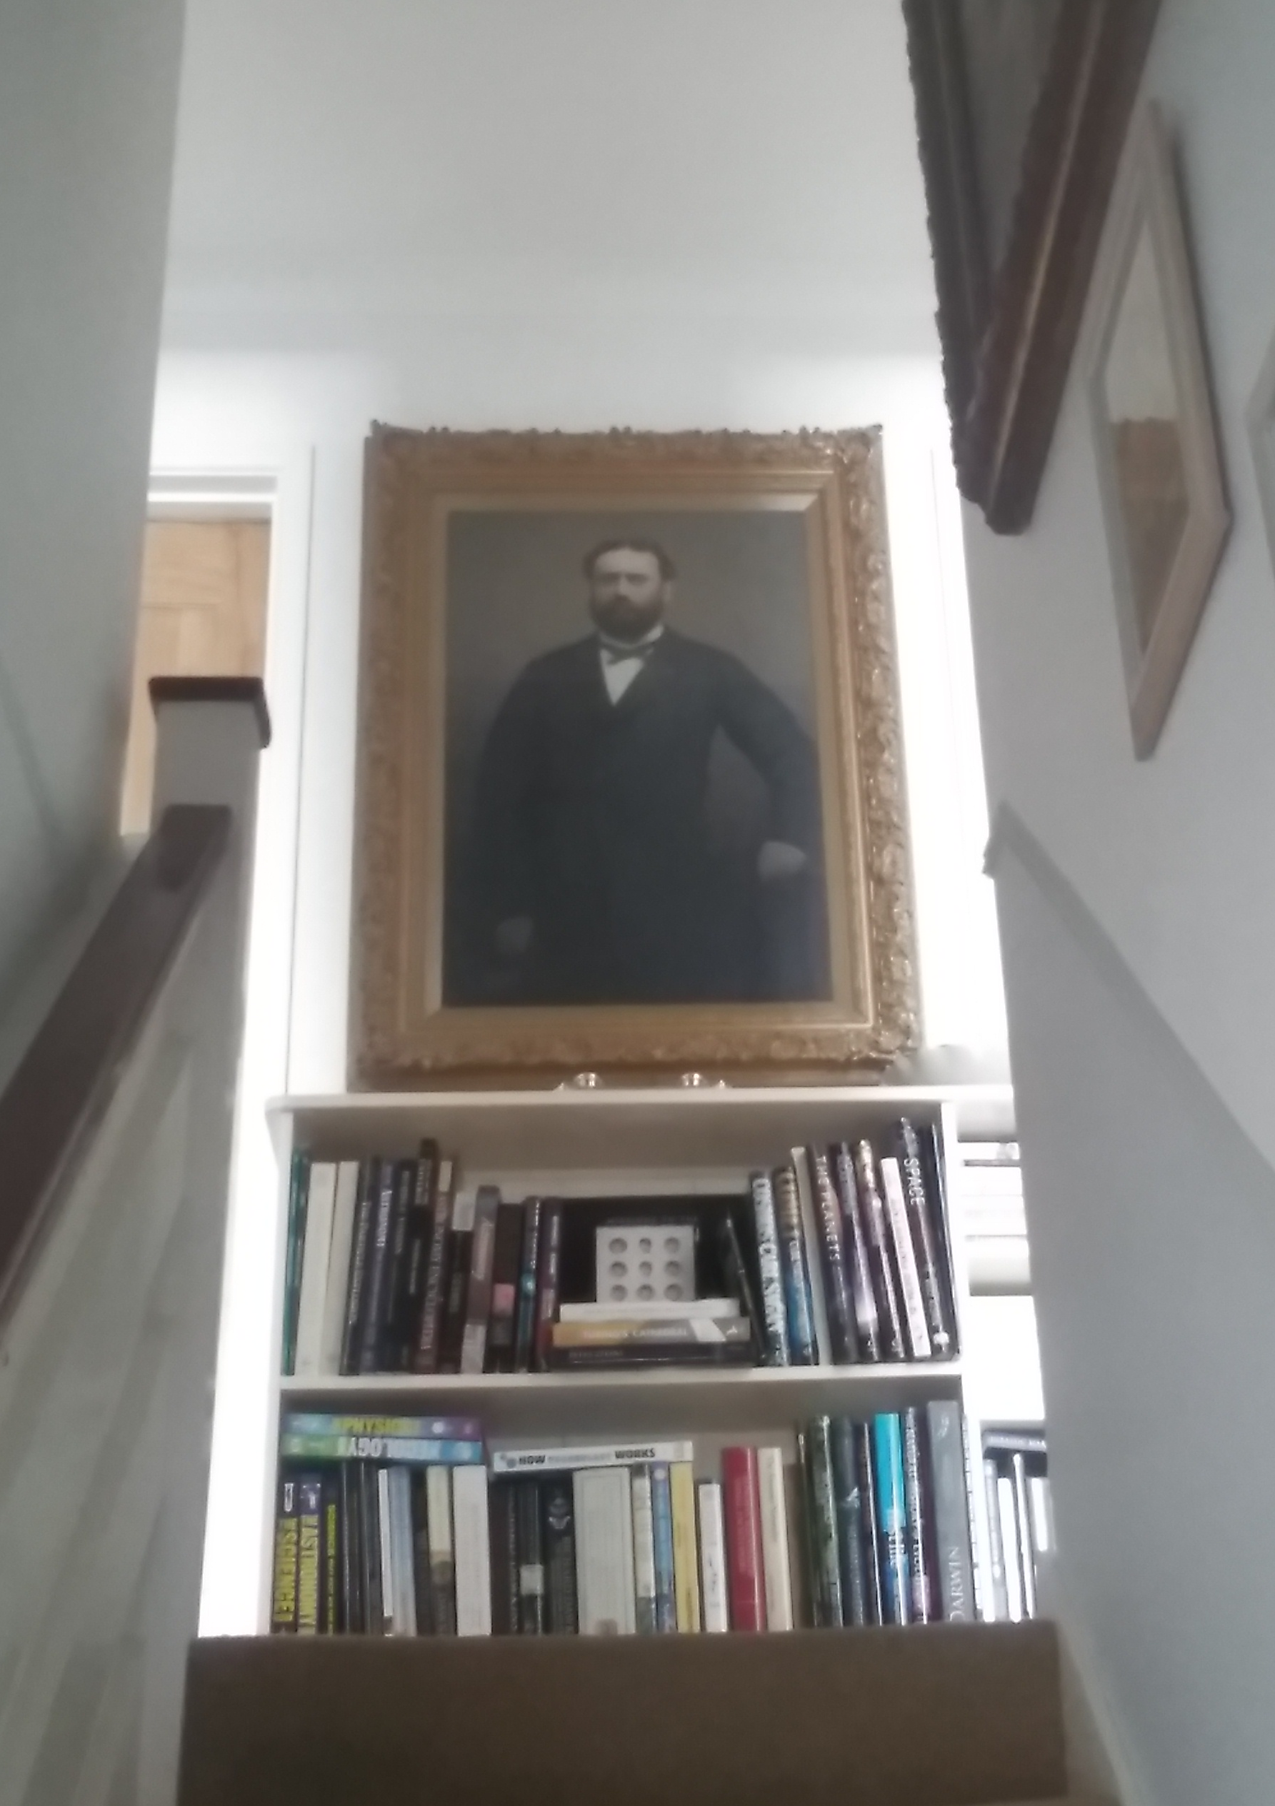
Tancred Agius
1827-1872

Slide 16
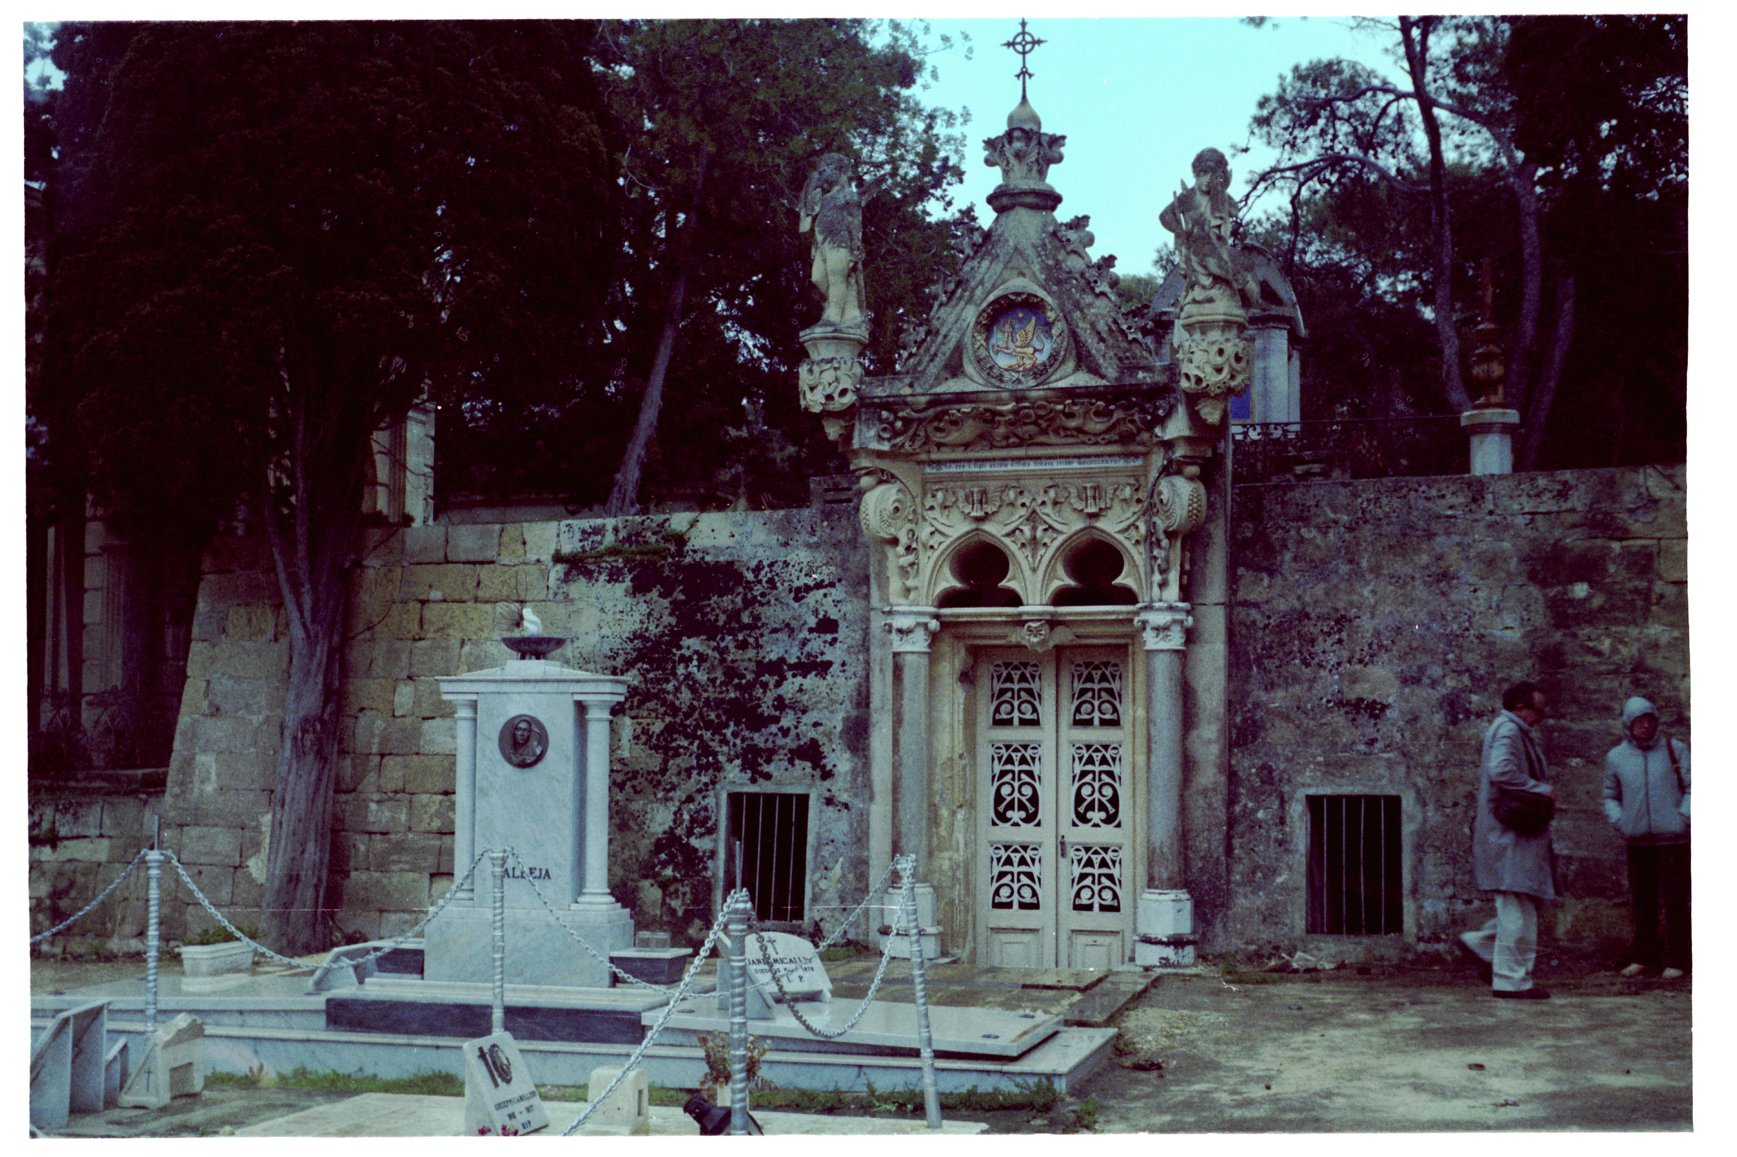
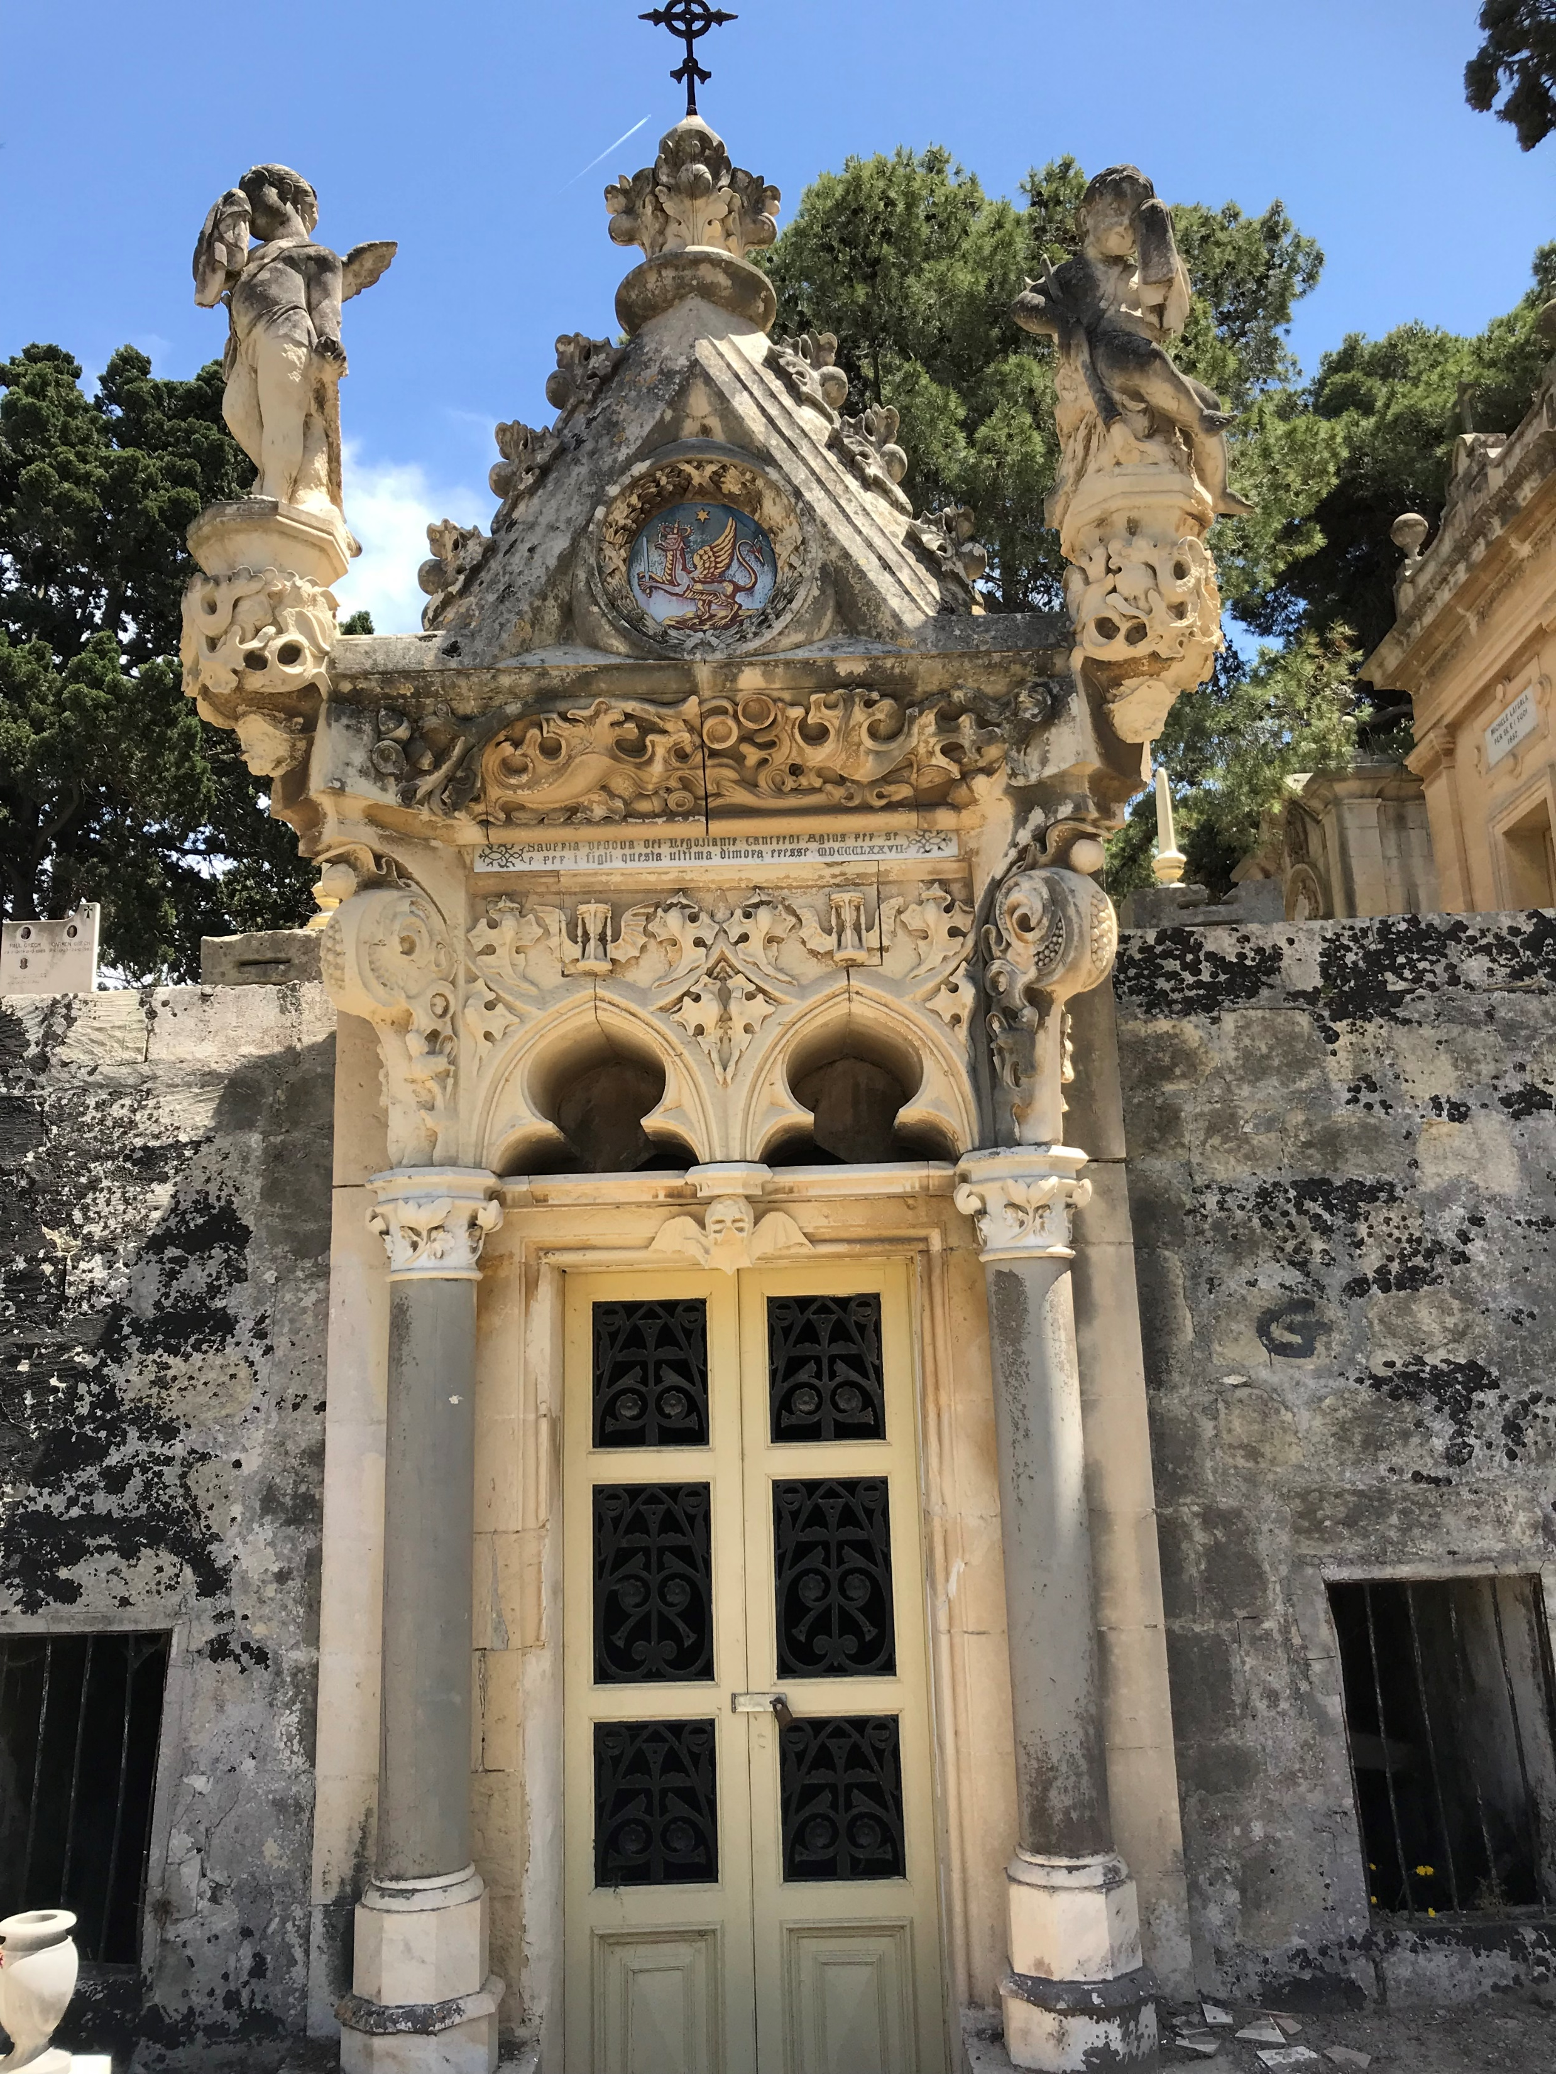
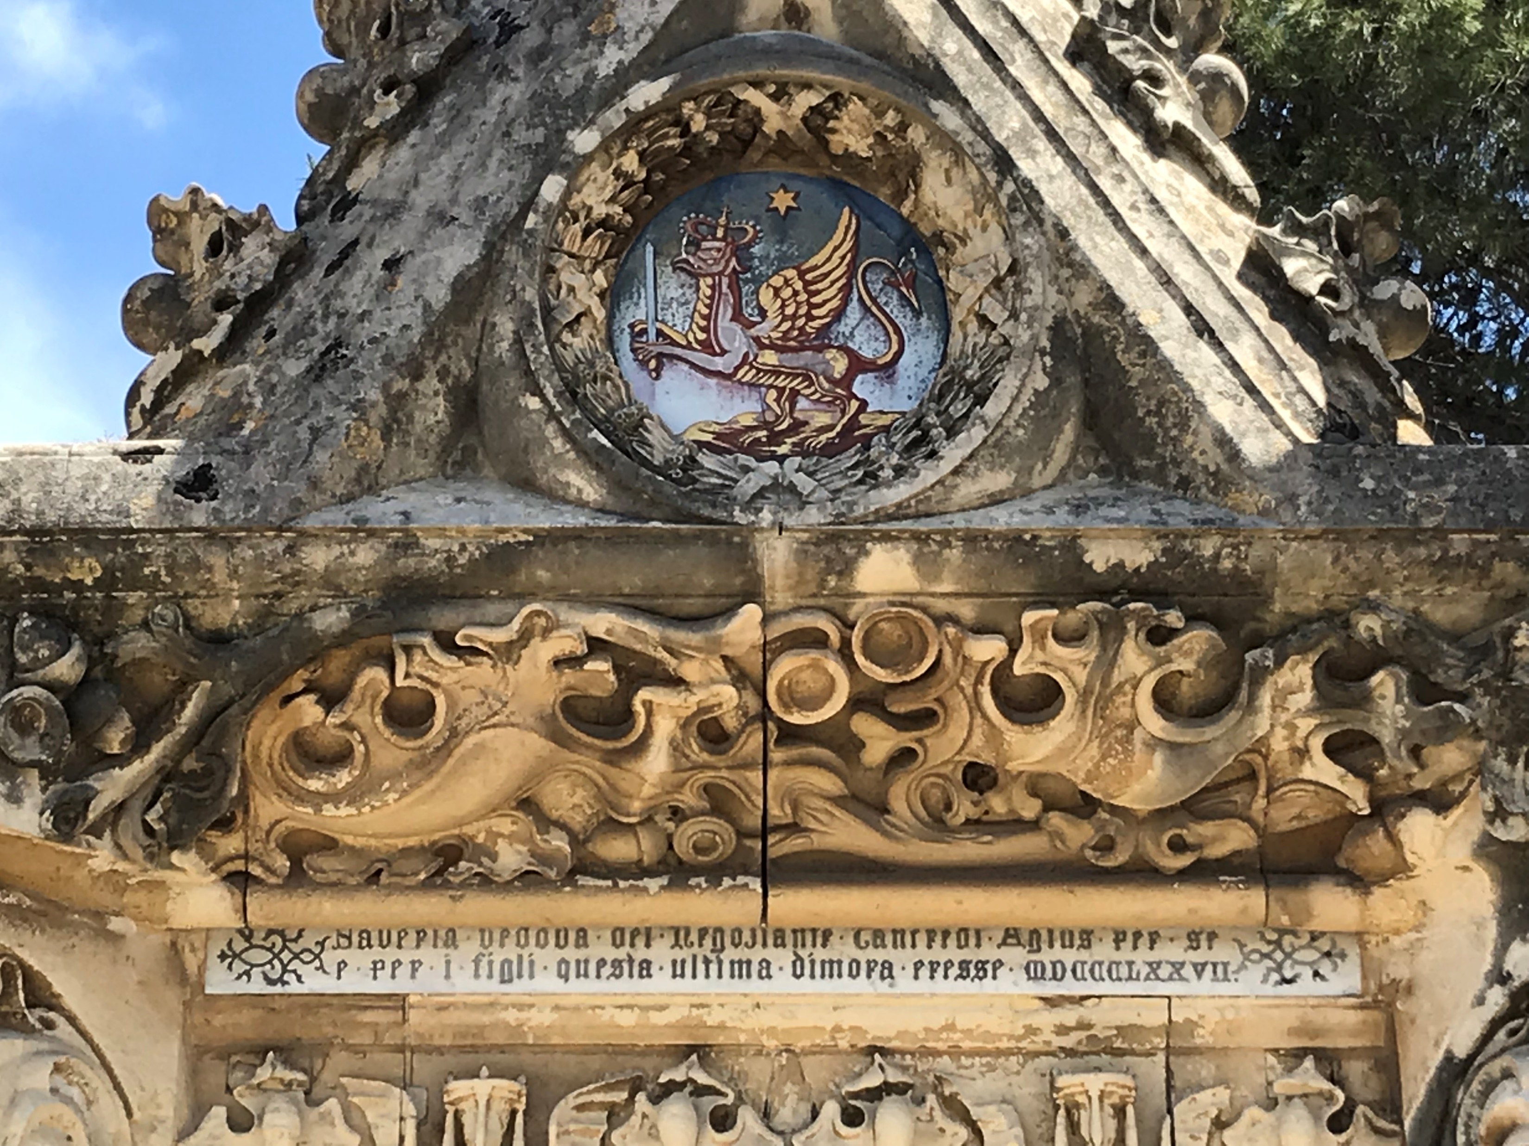

Slide 17
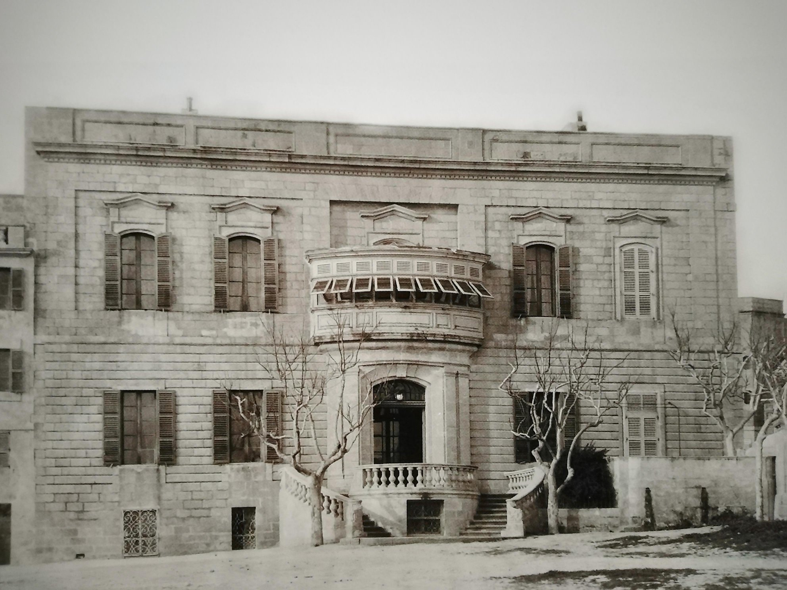
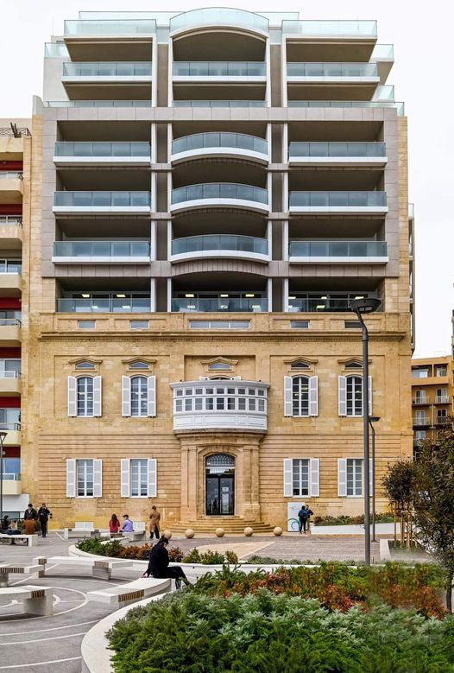

Slide 18
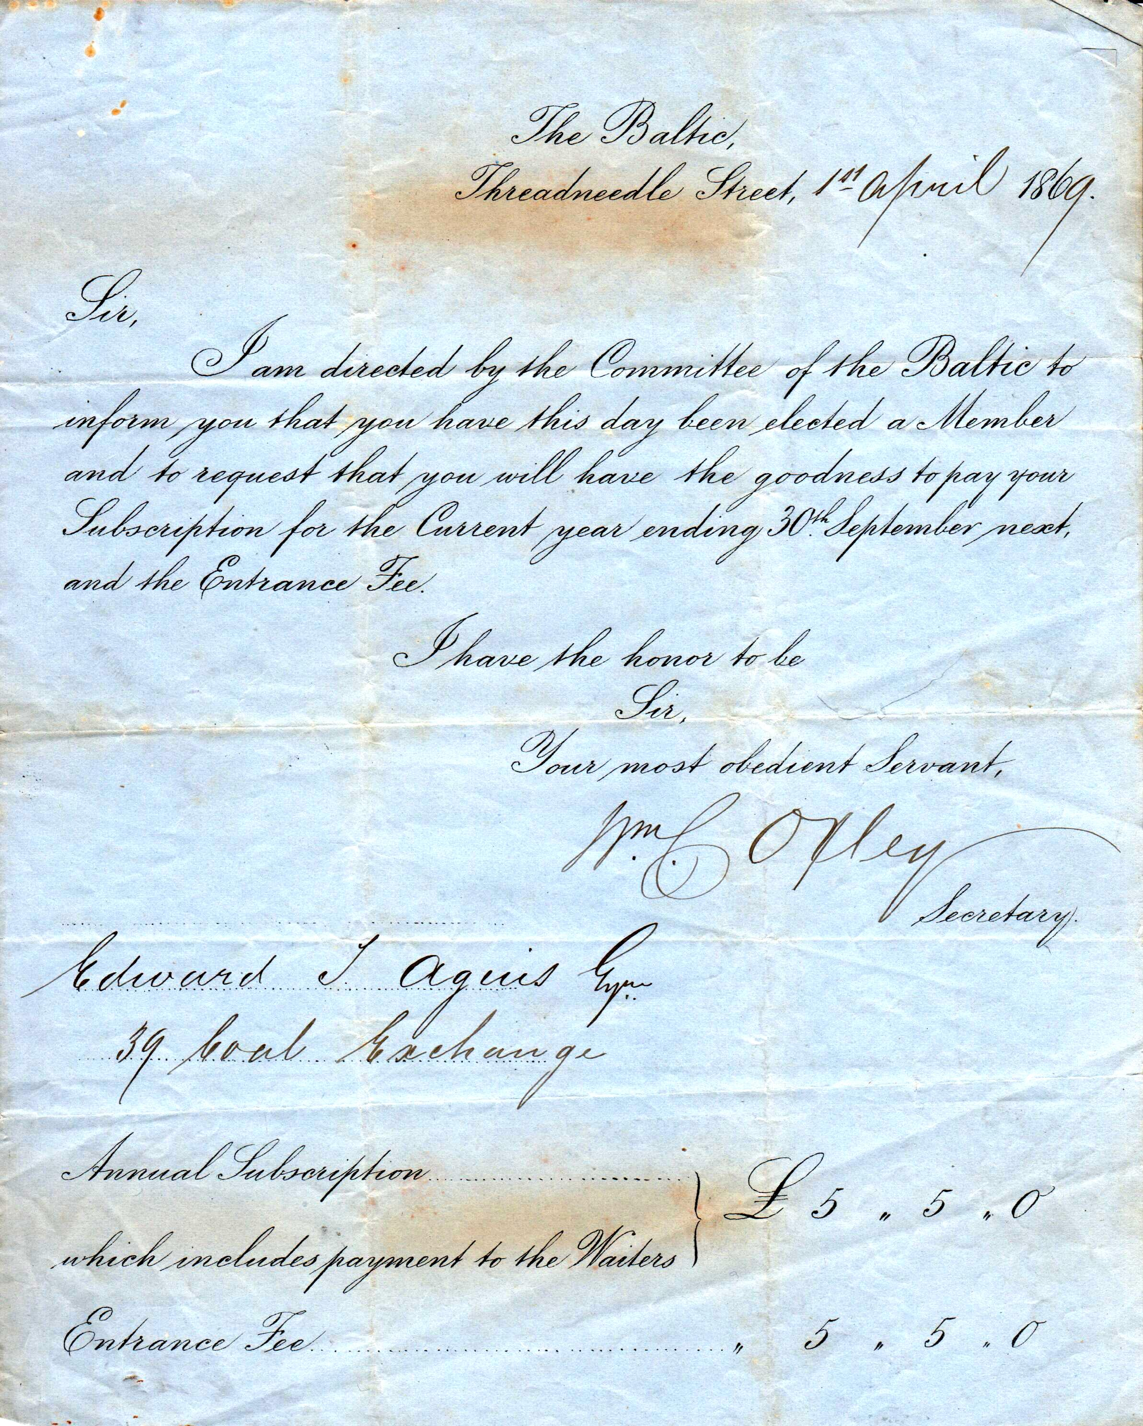
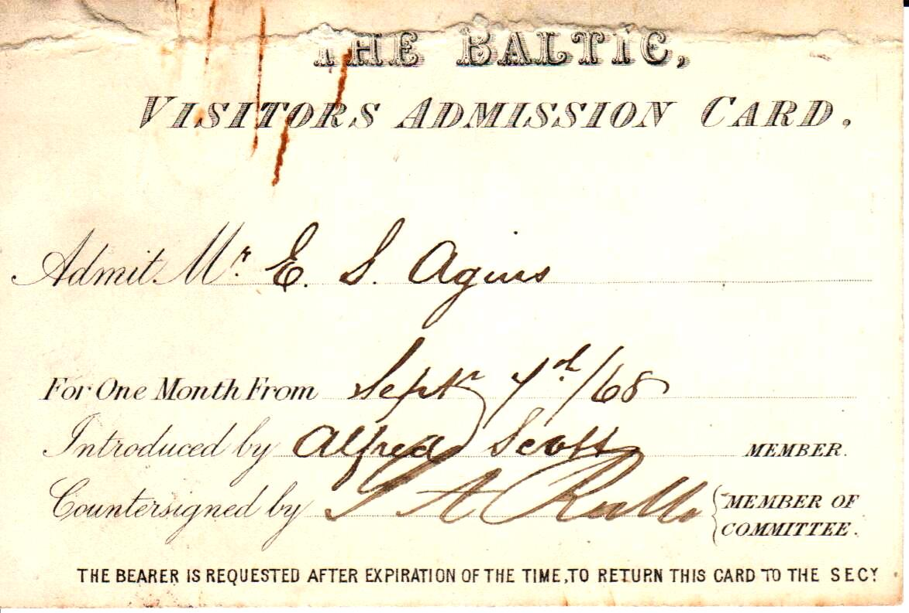

Slide 19
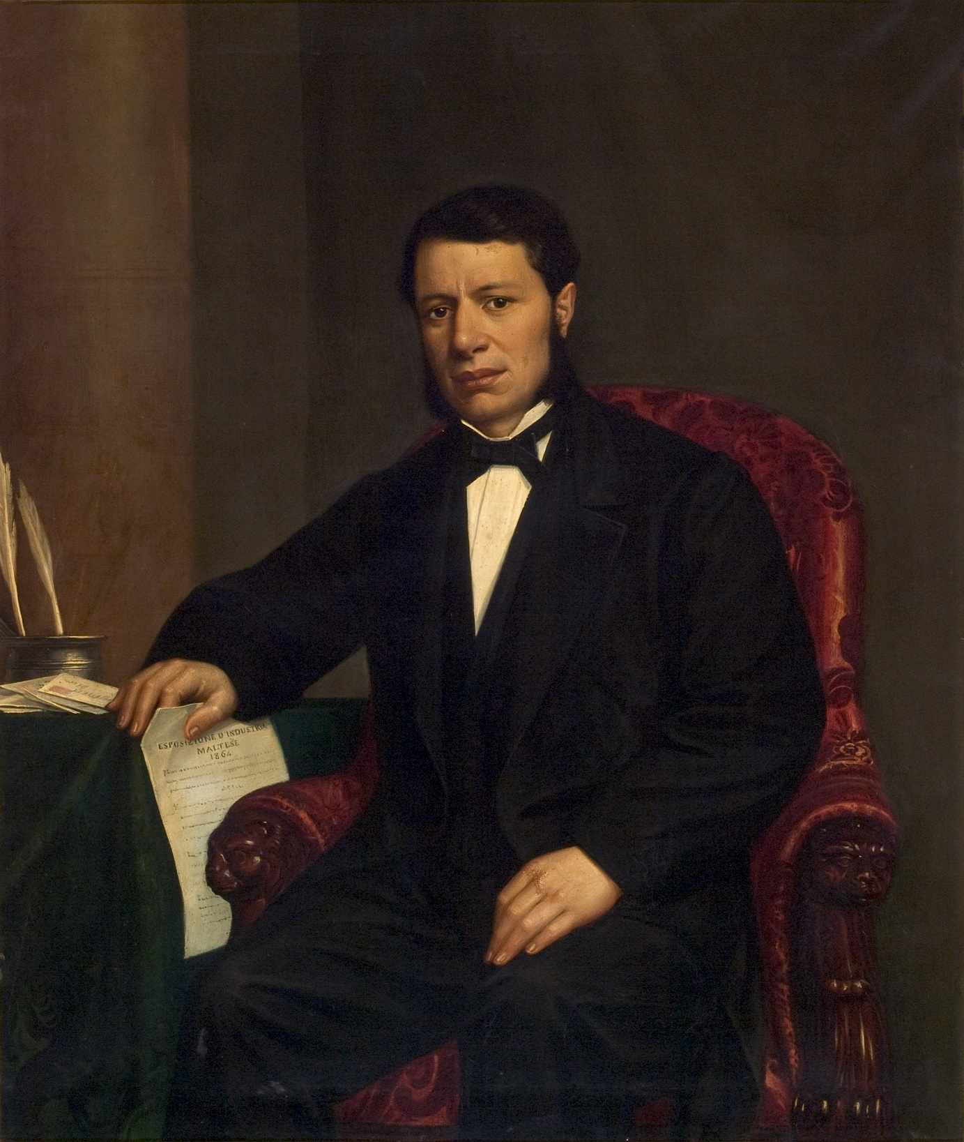
Carlo Maria Muscat

Slide 20
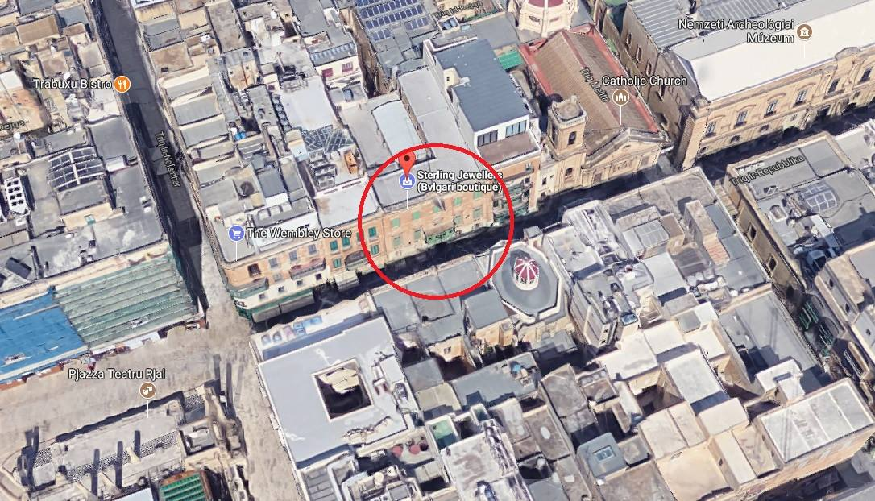

Slide 21
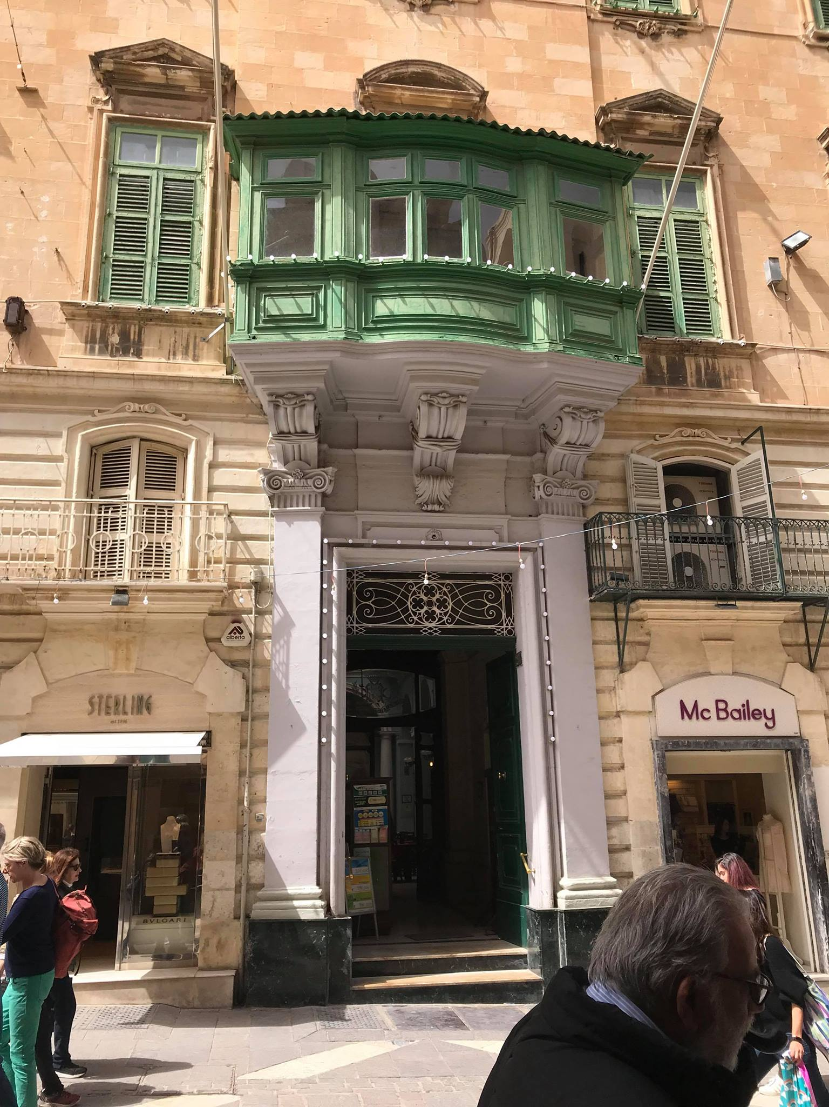
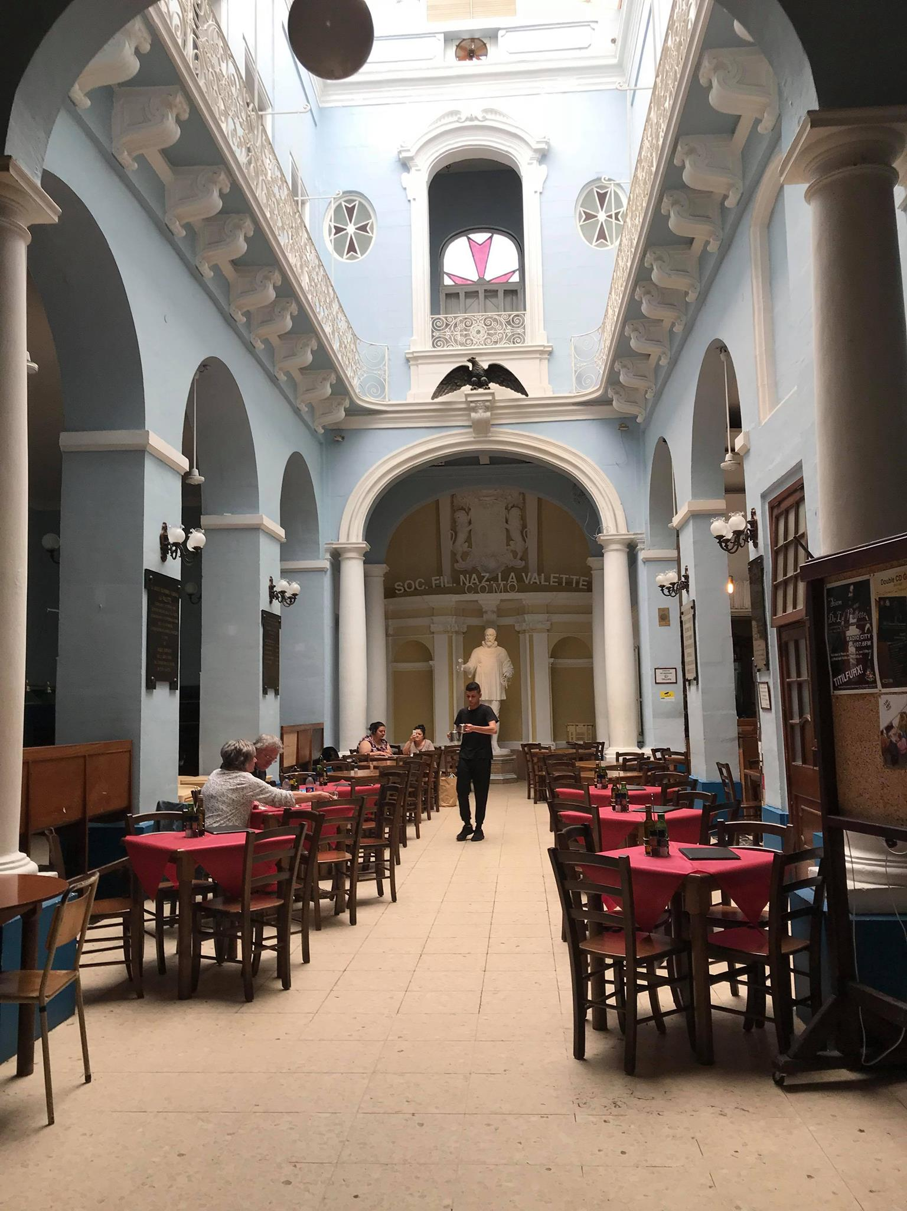

Slide 22
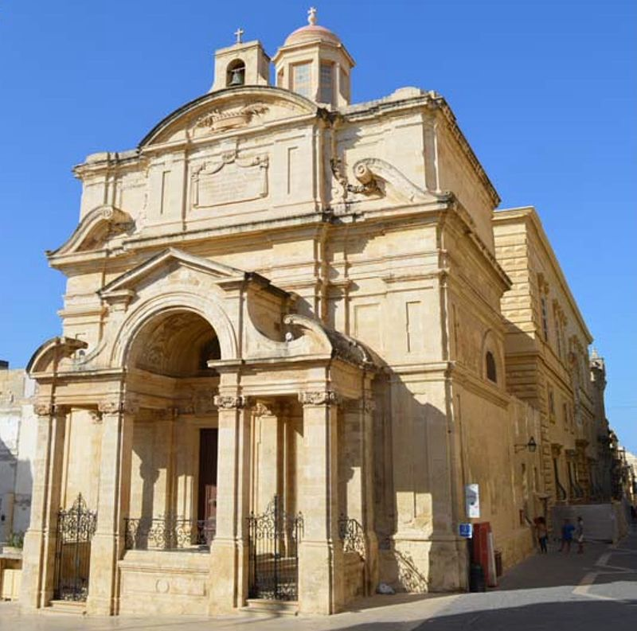

Slide 23
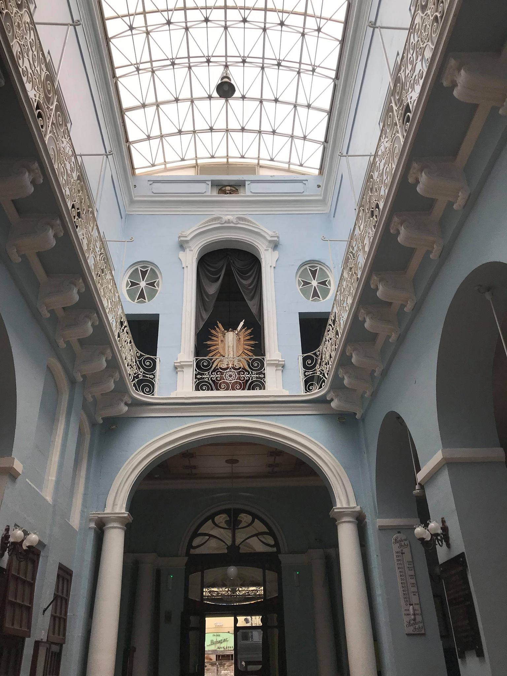

Slide 24
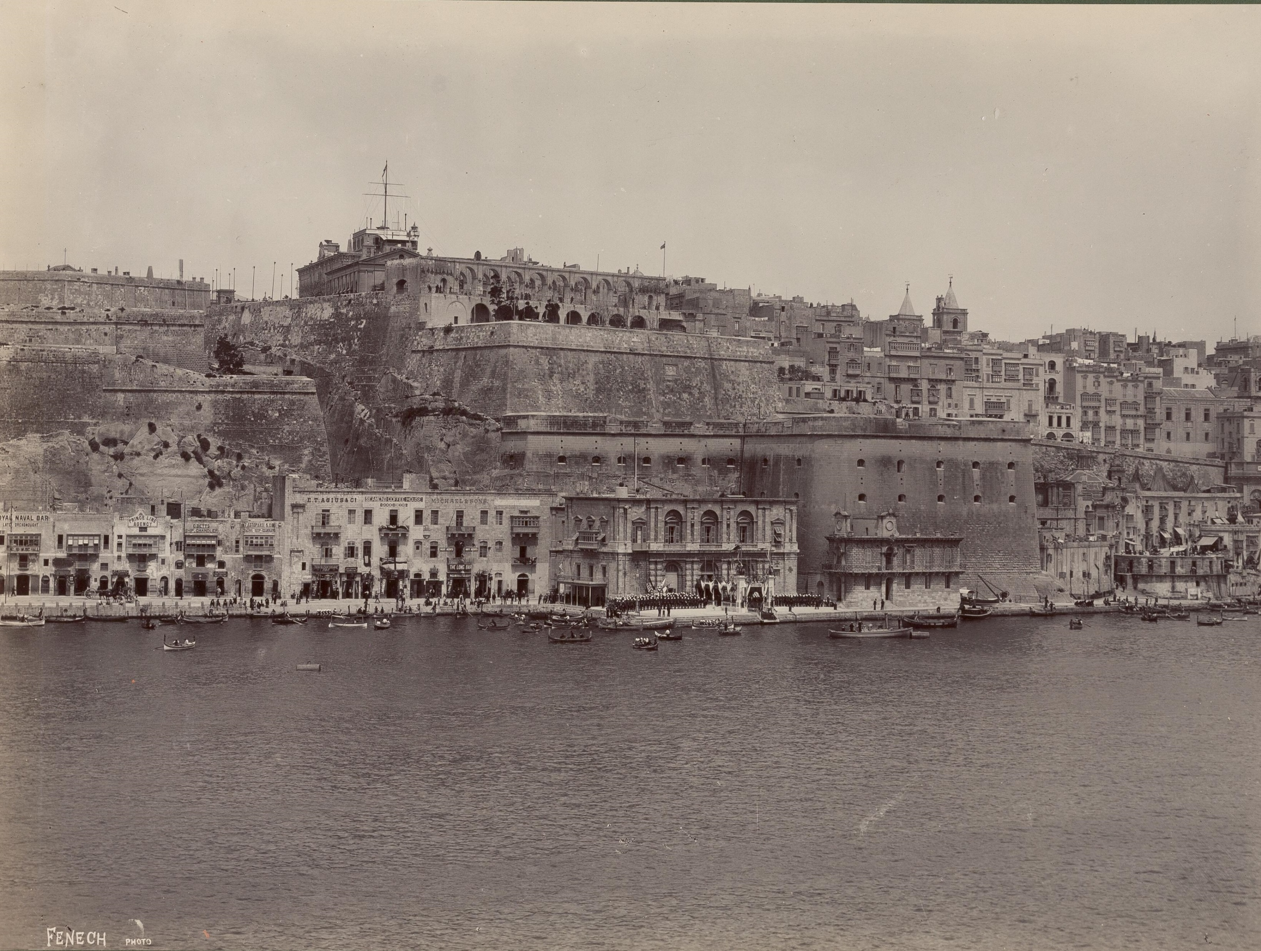

Slide 25
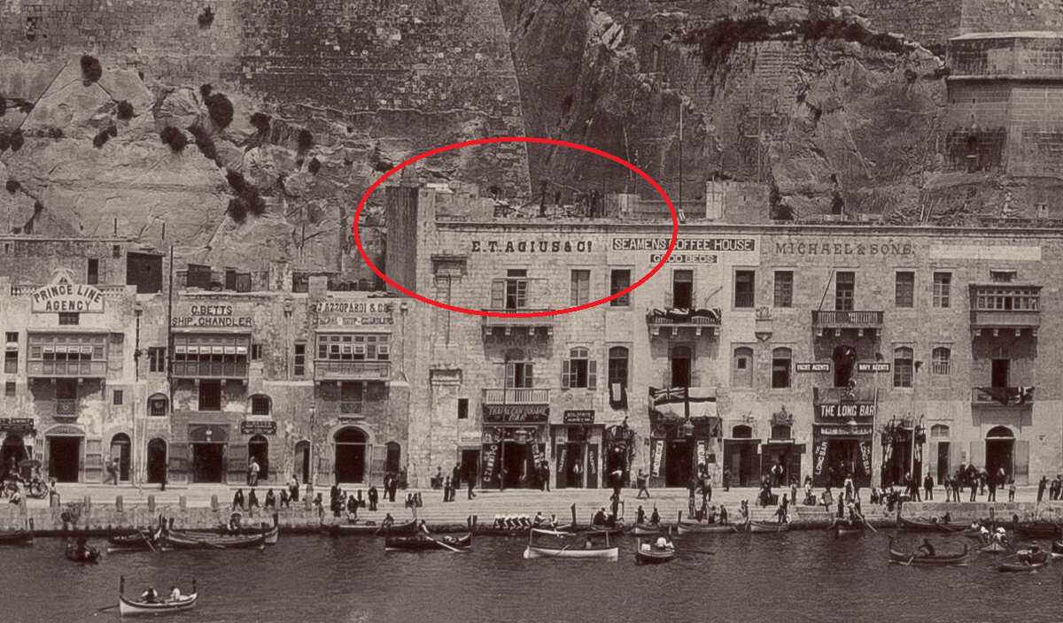
E T Agius & Co office on Lascaris Wharf

Slide 26
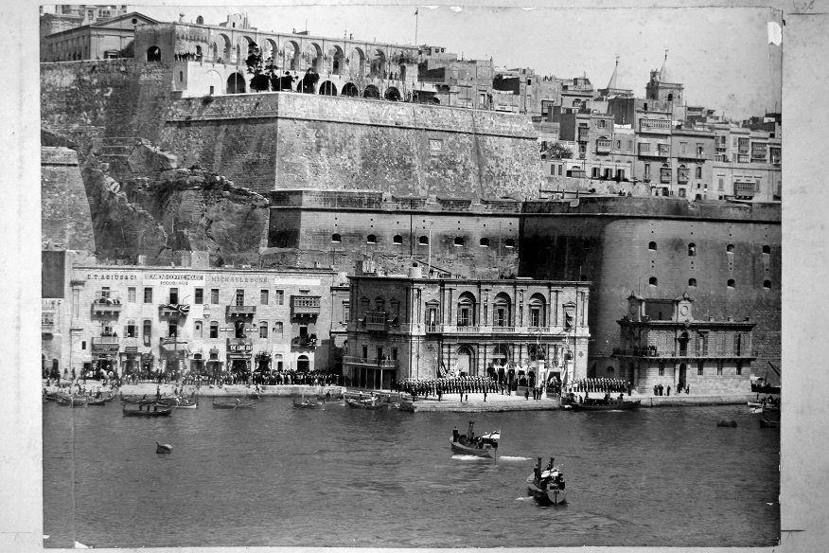

Slide 27
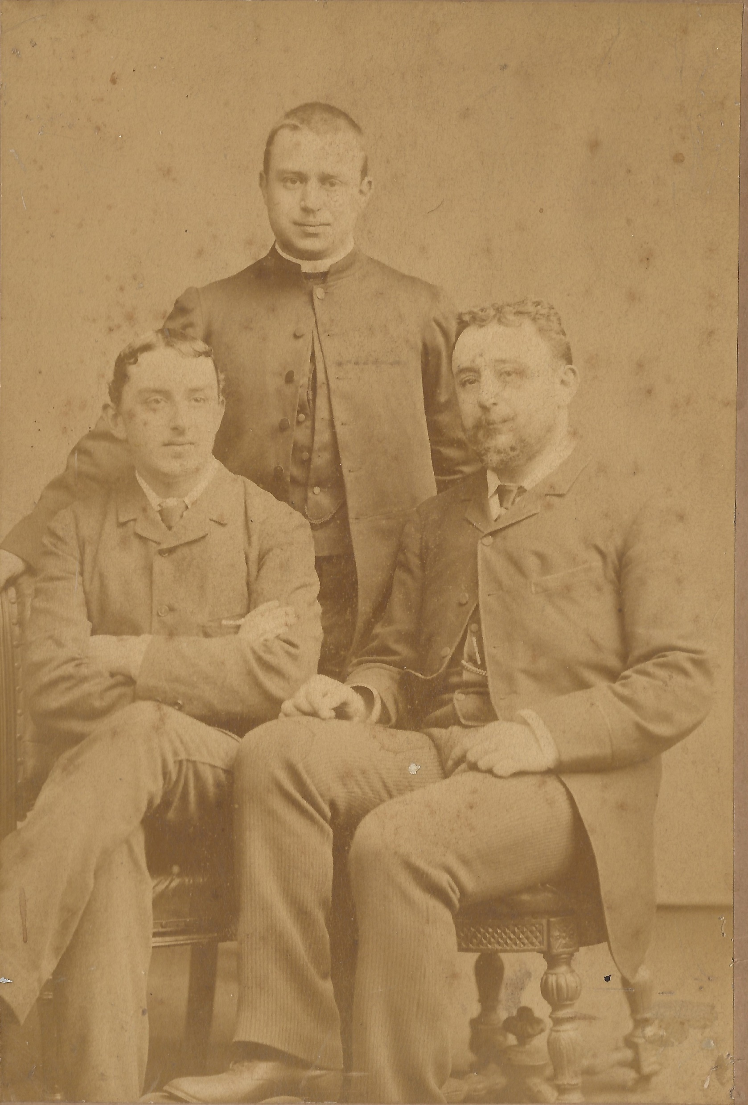
Edward b 1849
Dom Ambrose b 1856
Edgar b1864
c1880

Slide 28
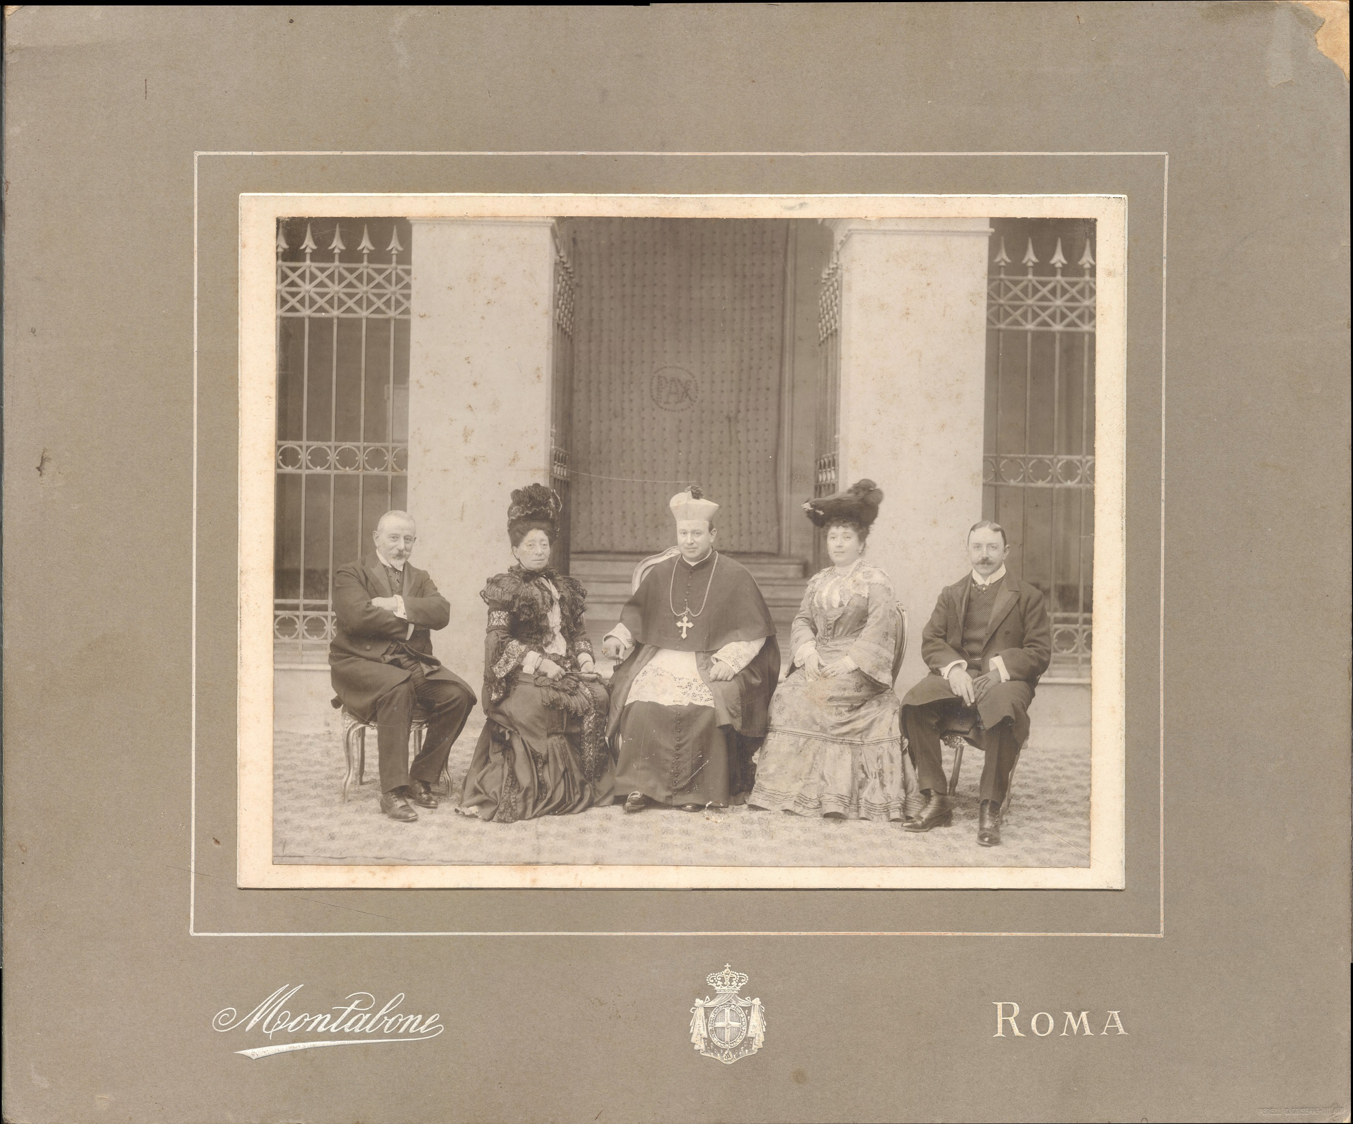

Slide 29
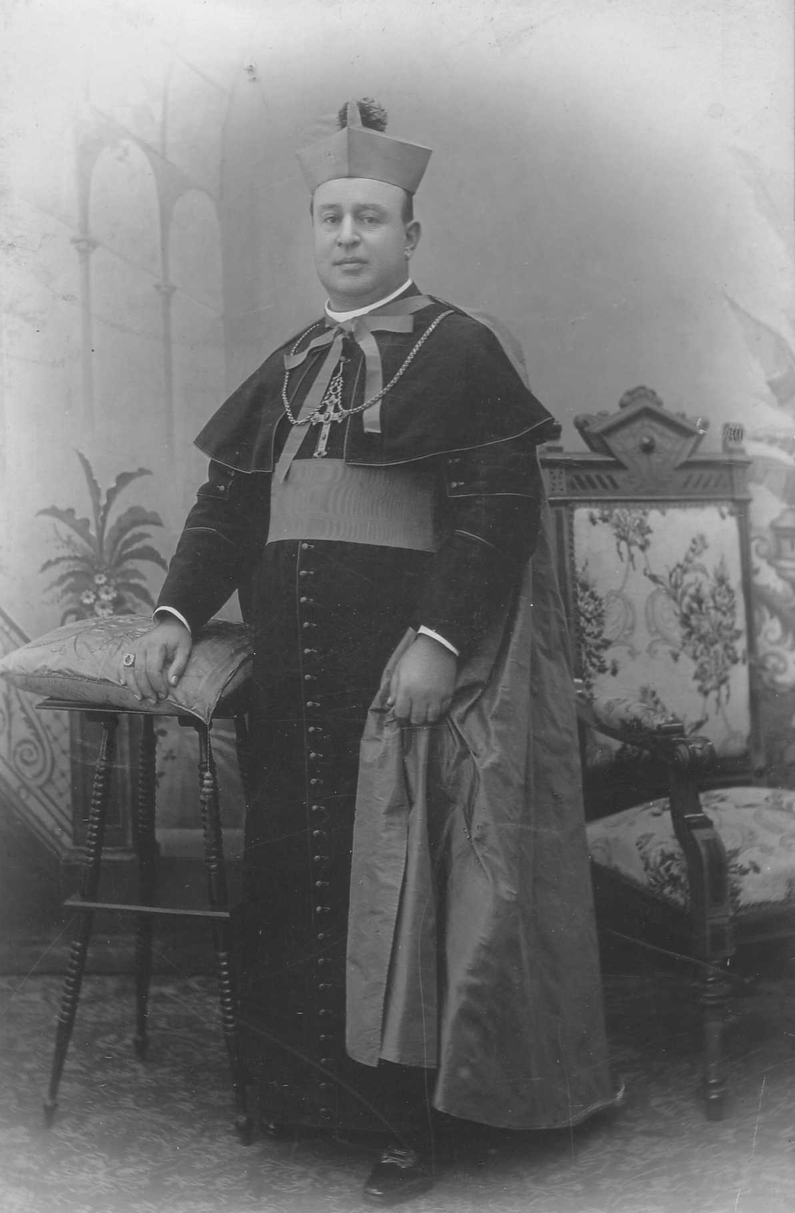

Slide 30
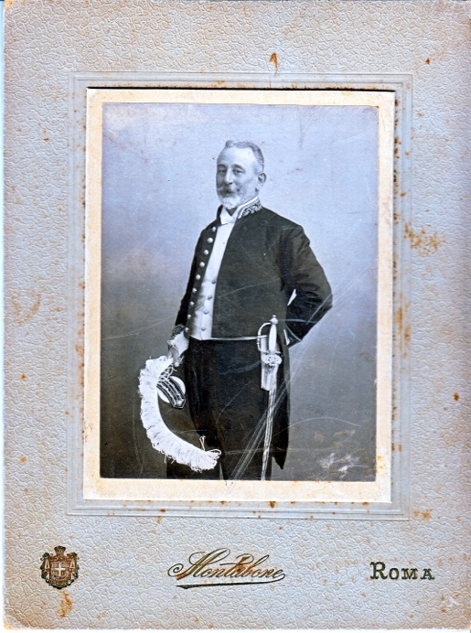

Slide 31
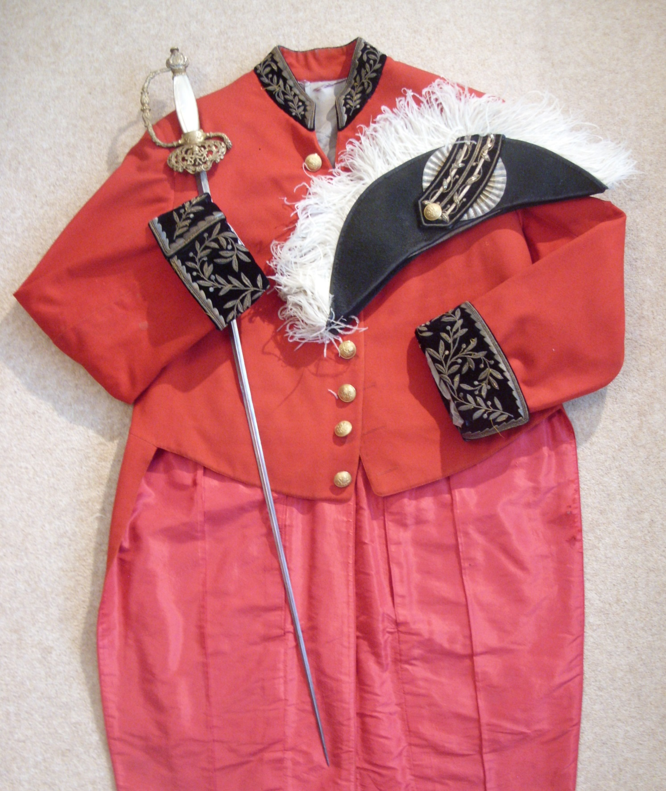

Slide 32
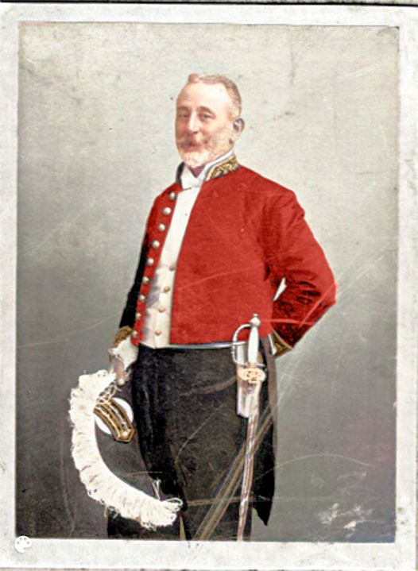

Slide 33
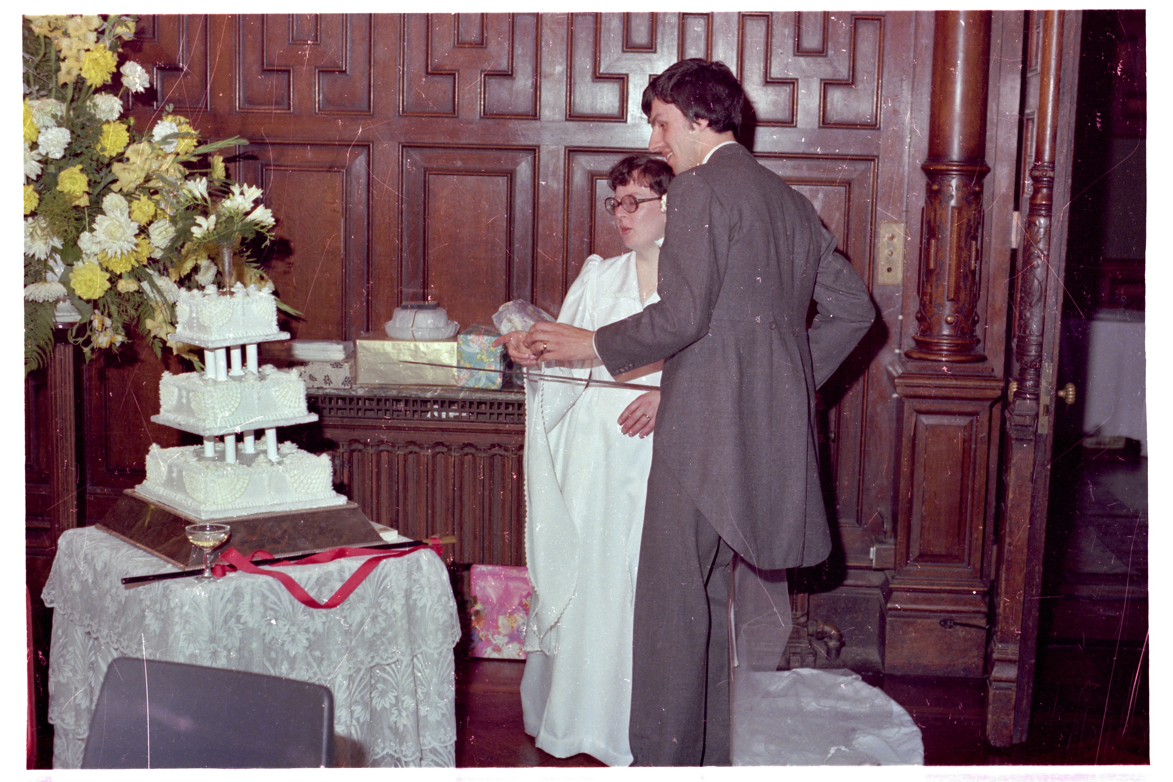
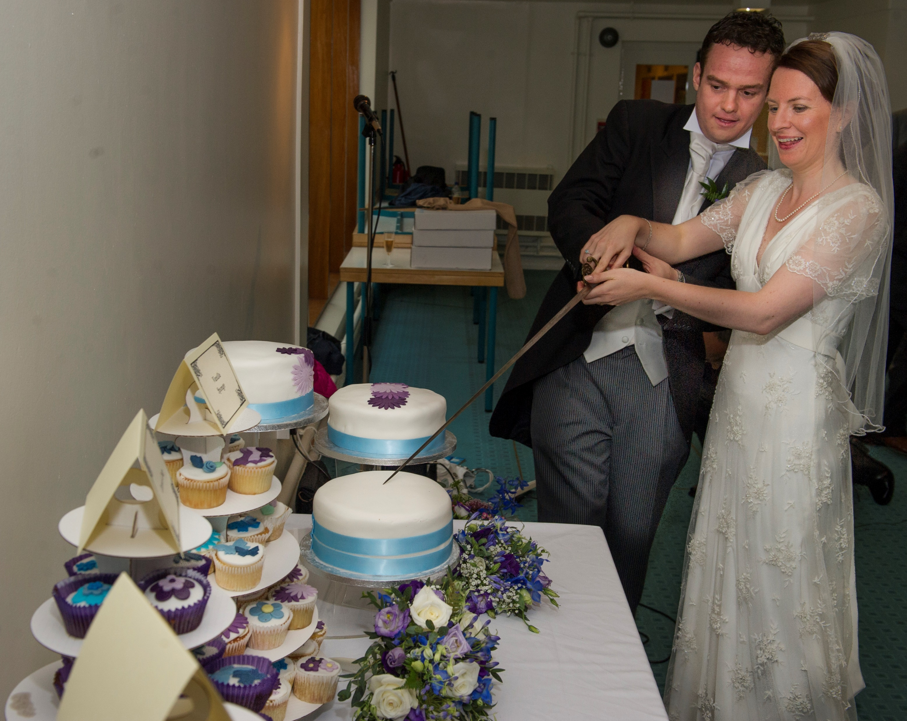
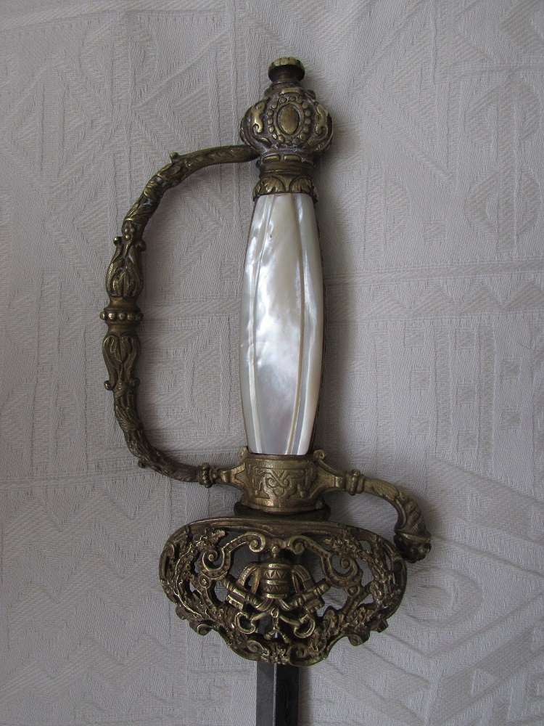
The ‘Papal’ sword !

Slide 34
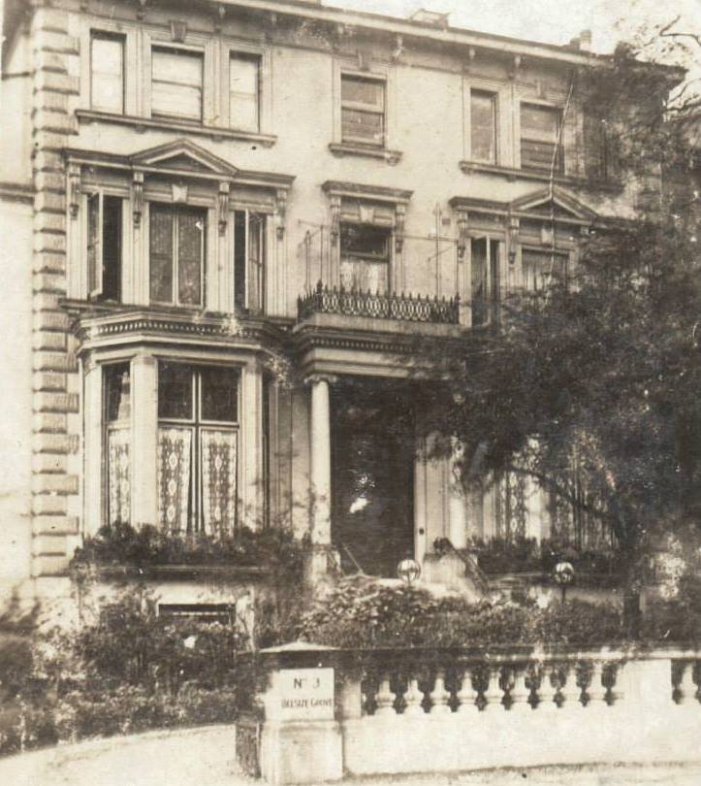

Slide 35
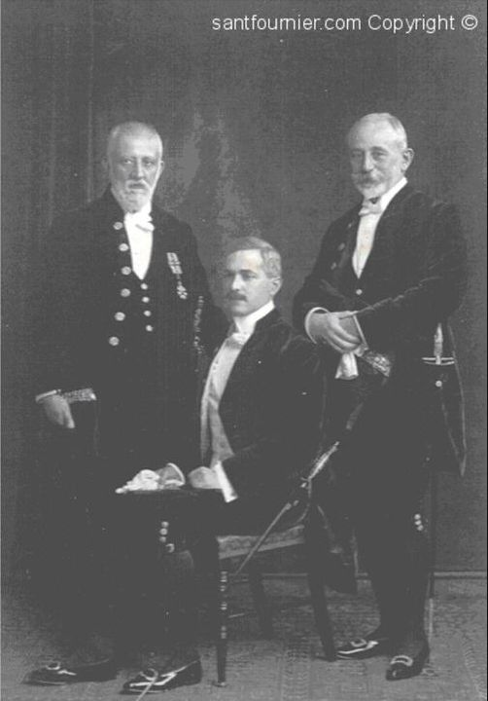

Slide 36
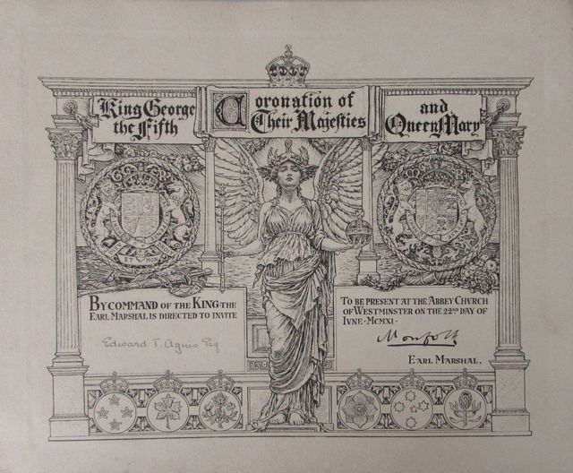

Slide 37
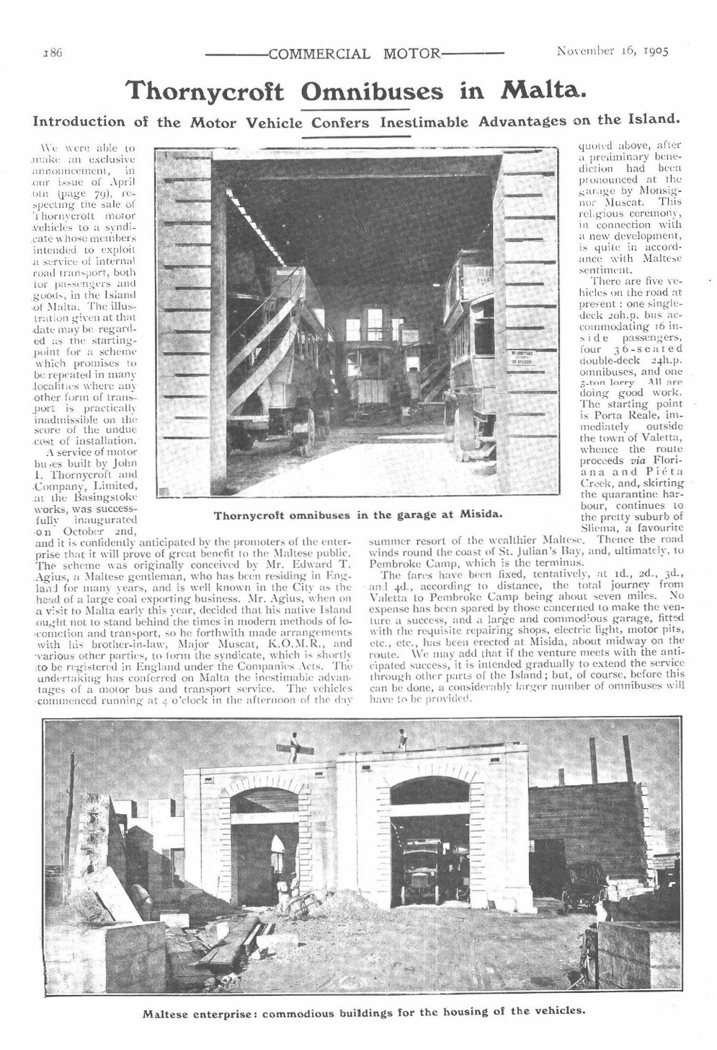

Slide 46
Marie & Suzanne Agius presenting bouquets
to Queen Elena and Queen Mary

Slide 47
Achilles Samut
1859-1935
Enrichetta nee Tagliaferro
1859-1933

Slide 57
Capt Richard Agius
kia
26 October 1917

Slide 59
http://agiusww1.com/mary-muscat-2/

Slide 61
Major Marie Agius QARANC
1915 -1967

Slide 62
Conspiracy of the Slaves
And
The plot to assassinate
Grandmaster Pinto
June 1749

Slide 65
Robert Samut
1869-1934

Slide 66
L’Innu Malti – Words Dun Karm Psaila – Music Robert Samut
Lil din l-art ħelwa, l-Omm li tatna isimha,
Ħares, Mulej, kif dejjem Int ħarist:
Ftakar li lilha bil-oħla dawl libbist.
Agħti, kbir Alla, id-dehen lil min jaħkimha,
Rodd il-ħniena lis-sid, saħħa 'l-ħaddiem:
Seddaq il-għaqda fil-Maltin u s-sliem.
This sweet land, the Mother that gave us her name,
Protect her, Lord, as You have always protected her:
Remember that You clothed her with the sweetest light.
Give, great God, discernment to those who rule her,
Return mercy to the owner, health to the worker:
Confirm us all, in unity and peace!

